Slide 1



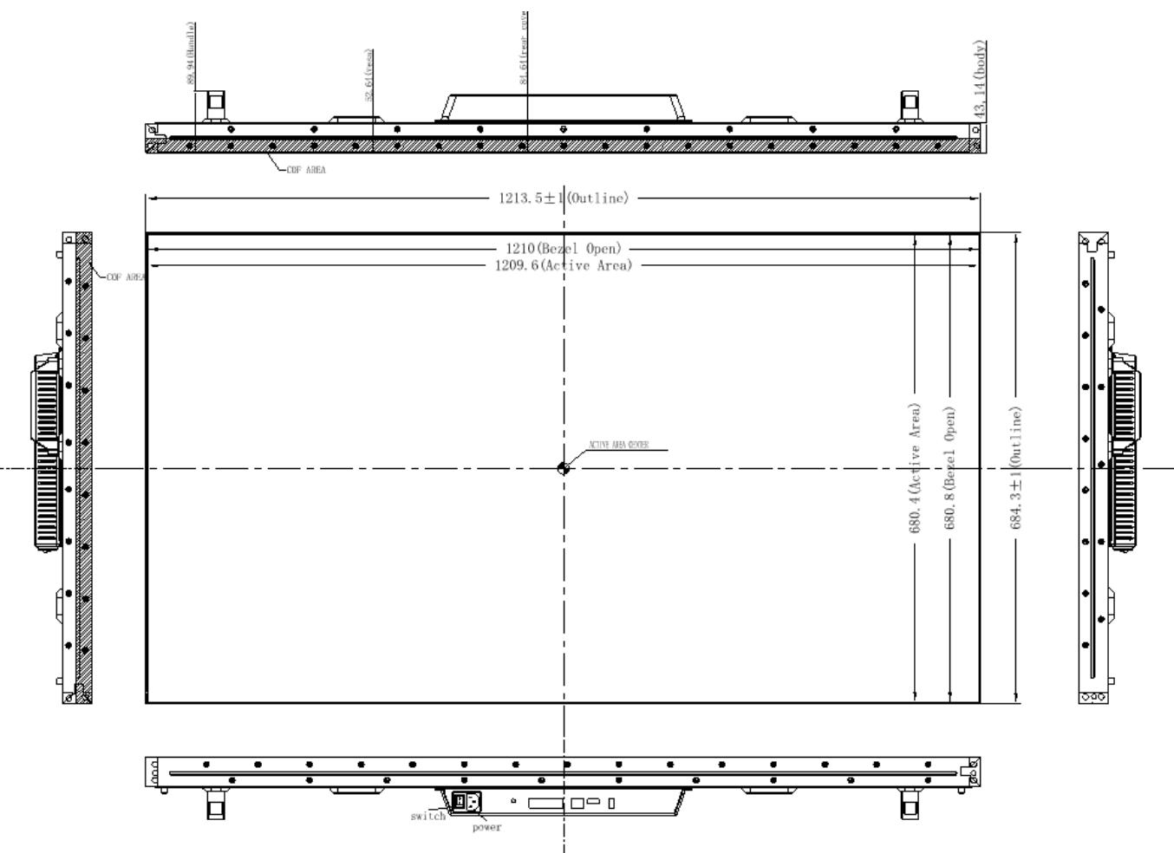
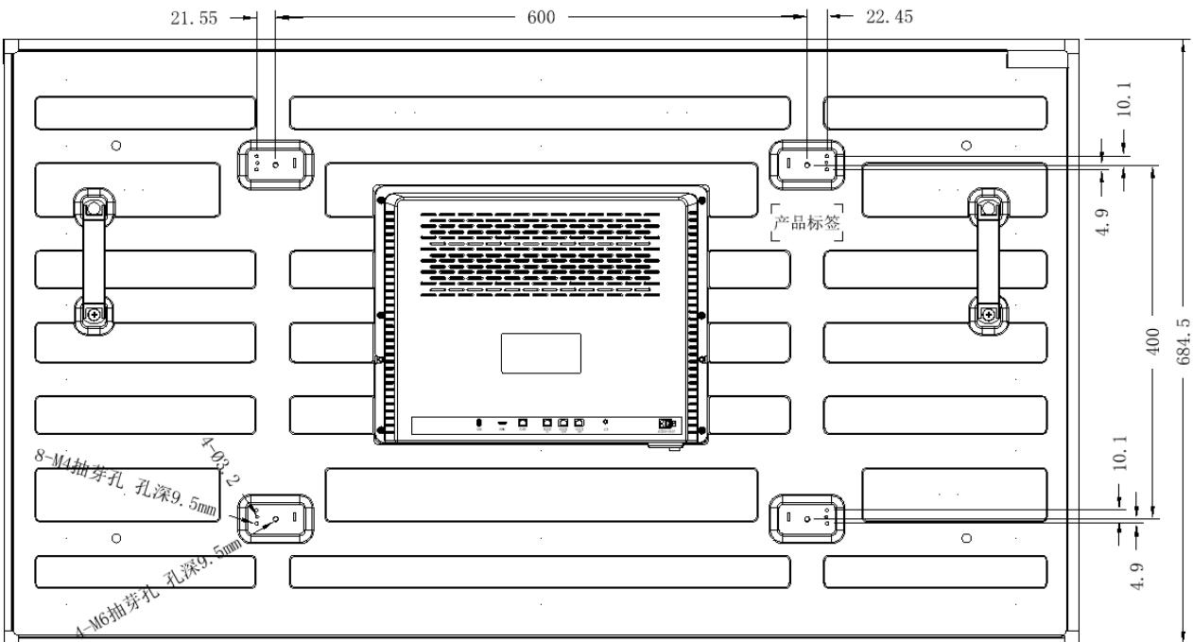
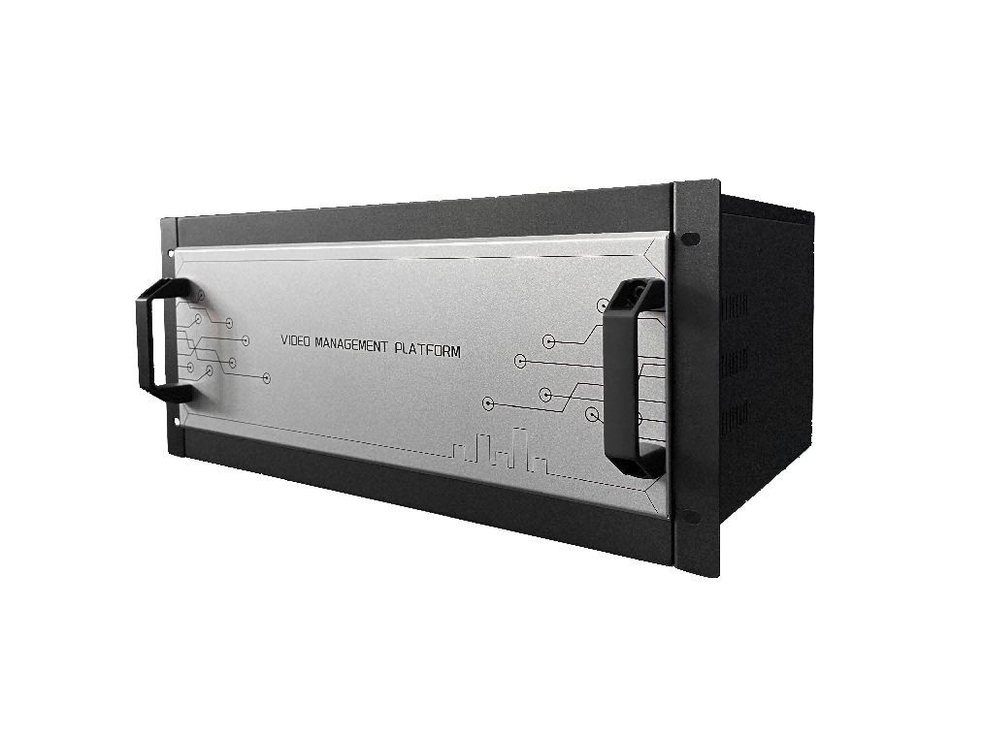
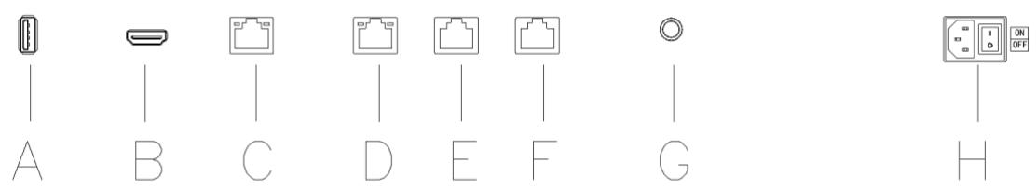
TECHNICAL PRODUCT PORTFOLIO
Video Wall Display & Network Decoding System
NX-VP-5535
Detailed model selection for overseas B2B projects, system integration and procurement
NX-VP-5535
NX-VP-5535
TECHNICAL DATA
MODEL SELECTION
PROJECT RFQ
4
4
13
catalog models
product families
application contexts
NX-VP-5535
NX-VD-4K16
Notes:
[Sources]
- D:\Nexpro-link 产品数据库\artifacts\NPL-DB-0203\product-artifact-manifest.json
- D:\NexPro-Link-安放解决方案供应商网站\public\images\video-wall\products\NX-VP-5535\main.jpg
- D:\NexPro-Link-安放解决方案供应商网站\public\images\video-wall\products\NX-VP-5535\dimensions.jpg
- D:\NexPro-Link-安放解决方案供应商网站\public\images\video-wall\products\NX-VP-5535\rear-structure.jpg
- D:\NexPro-Link-安放解决方案供应商网站\public\images\video-wall\products\NX-VP-5535\interface-layout.jpg
- D:\NexPro-Link-安放解决方案供应商网站\public\images\video-wall\products\NX-VD-4K16\main.png

Slide 2
VIDEO WALL DISPLAY & NETWORK DECODING SYSTEM
Application landscape
NX-VP-5535
NX-VP-5535
NX-VP-5535
Security control room
Command center
Monitoring center
Presentation wall
CCTV command center
Security operations center
Large monitoring wall
Multi-source display
Security operator desk
PTZ camera control
Decoder operation
Compact monitoring desk
NexPro Product Intelligence · Project configurations are confirmed through RFQ
02
Notes:
[Sources]
- D:\Nexpro-link 产品数据库\artifacts\NPL-DB-0203\product-artifact-manifest.json
- D:\NexPro-Link-安放解决方案供应商网站\public\images\video-wall\products\NX-VP-5535\main.jpg
- D:\NexPro-Link-安放解决方案供应商网站\public\images\video-wall\products\NX-VP-5535\dimensions.jpg
- D:\NexPro-Link-安放解决方案供应商网站\public\images\video-wall\products\NX-VP-5535\rear-structure.jpg

Slide 3
VIDEO WALL DISPLAY & NETWORK DECODING SYSTEM
Portfolio structure
55-inch LCD Video Wall Panel for Control Room Display
4K Network Video Decoder with Video Wall Management
5-inch Network PTZ Control Keyboard
1 model
NX-VP-5535
1 model
NX-VD-4K16
1 model
NX-PC-5S3
5-inch HD IP Joystick Controller
1 model
NX-PC-5HD
NexPro Product Intelligence · Project configurations are confirmed through RFQ
03
Notes:
[Sources]
- D:\Nexpro-link 产品数据库\artifacts\NPL-DB-0203\product-artifact-manifest.json

Slide 4
VIDEO WALL DISPLAY & NETWORK DECODING SYSTEM
Technical data · NX-VP-5535 · 1/1
PARAMETER
APPROVED SPECIFICATION
Panel size
55 inches
Combined bezel
3.5 mm
Resolution
1920 × 1080
Brightness
400 nit typical
Viewing angle
178° H / V; 178° horizontal / vertical
Power
Up to 150 W
Contrast ratio
1200:1 typical
Response time
8 ms typical
NX-VP-5535
Backlight
D-LED
Dimensions
1213.5 × 684.3 × 89.94 mm
55-inch LCD Video Wall Panel for Control Room Display
Net weight
14.4 kg
Power consumption
Up to 150 W
Approved parameters 1–13 of 13
Mounting review
Confirm wall, cabinet or front-maintenance structure from the approved project drawing
This product section contains every approved customer-facing specification field for the exact model. Missing source values are stated explicitly.
NexPro Product Intelligence · Project configurations are confirmed through RFQ
04
Notes:
[Sources]
- D:\Nexpro-link 产品数据库\artifacts\NPL-DB-0203\product-artifact-manifest.json
- D:\NexPro-Link-安放解决方案供应商网站\src\data\products.ts
- D:\NexPro-Link-安放解决方案供应商网站\public\images\video-wall\products\NX-VP-5535\main.jpg

Slide 5
VIDEO WALL DISPLAY & NETWORK DECODING SYSTEM
Technical data · NX-VD-4K16 · 1/1
PARAMETER
APPROVED SPECIFICATION
Chassis
5U modular chassis
Modules
Up to 16
Maximum output
3840 × 2160 at 60 Hz
Wall outputs
Up to 32 displays
Network
Gigabit Ethernet
Power
Up to 160 W
Chassis dimensions
430 × 300 × 210 mm
Module capacity
Up to 16 modules
NX-VD-4K16
Maximum 5U wall outputs
32 displays
Video decoding
H.265+, H.265, H.264, MPEG4 and MJPEG
4K Network Video Decoder with Video Wall Management
Window layouts
1 / 4 / 6 / 8 / 9 / 10 / 16 / 25 / 36
Integration protocols
ONVIF, GB28181, RTSP, RTP and SDK
Power consumption
Up to 160 W
Approved parameters 1–14 of 14
Operating temperature
-10 to 55 °C
This product section contains every approved customer-facing specification field for the exact model. Missing source values are stated explicitly.
NexPro Product Intelligence · Project configurations are confirmed through RFQ
05
Notes:
[Sources]
- D:\Nexpro-link 产品数据库\artifacts\NPL-DB-0203\product-artifact-manifest.json
- D:\NexPro-Link-安放解决方案供应商网站\src\data\products.ts
- D:\NexPro-Link-安放解决方案供应商网站\public\images\video-wall\products\NX-VD-4K16\main.png

Slide 6
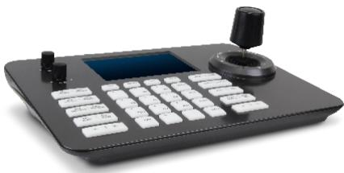
VIDEO WALL DISPLAY & NETWORK DECODING SYSTEM
Technical data · NX-PC-5S3 · 1/1
PARAMETER
APPROVED SPECIFICATION
Display
5-inch 800 × 480 TFT LCD
Managed devices
Up to 999
Decoding
1080p at 30 fps
Interfaces
RJ45 / RS422 / RS232; RJ45, RS422 and RS232
Power
DC 12 V / PoE
Consumption
Up to 5 W
Operating system
Linux
Video decoding
H.265 / H.264, up to 1080p at 30 fps
NX-PC-5S3
Control
Four-axis variable-speed joystick
Power consumption
Up to 5 W
5-inch Network PTZ Control Keyboard
Operating temperature
-10 to 55 °C
Approved parameters 1–11 of 11
This product section contains every approved customer-facing specification field for the exact model. Missing source values are stated explicitly.
NexPro Product Intelligence · Project configurations are confirmed through RFQ
06
Notes:
[Sources]
- D:\Nexpro-link 产品数据库\artifacts\NPL-DB-0203\product-artifact-manifest.json
- D:\NexPro-Link-安放解决方案供应商网站\src\data\products.ts
- D:\NexPro-Link-安放解决方案供应商网站\public\images\video-wall\products\NX-PC-5S3\main.jpg

Slide 7
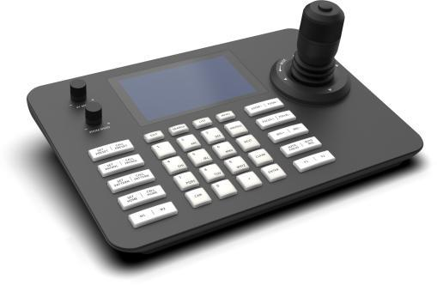
VIDEO WALL DISPLAY & NETWORK DECODING SYSTEM
Technical data · NX-PC-5HD · 1/1
PARAMETER
APPROVED SPECIFICATION
Display
5-inch 1280 × 720 LCD
Managed devices
Up to 254
Decoding
1080p at 30 fps
Interfaces
RJ45 / RS485 / RS422 / RS232; RJ45, RS485, RS422 and RS232
Power
DC 12 V / PoE
Consumption
Below 1.5 W
Operating system
Linux
Video decoding
H.264 / H.265, up to 1080p at 30 fps
NX-PC-5HD
Control
Four-axis joystick and rotary control
Power consumption
Below 1.5 W
5-inch HD IP Joystick Controller
Operating temperature
-10 to 50 °C
Approved parameters 1–11 of 11
This product section contains every approved customer-facing specification field for the exact model. Missing source values are stated explicitly.
NexPro Product Intelligence · Project configurations are confirmed through RFQ
07
Notes:
[Sources]
- D:\Nexpro-link 产品数据库\artifacts\NPL-DB-0203\product-artifact-manifest.json
- D:\NexPro-Link-安放解决方案供应商网站\src\data\products.ts
- D:\NexPro-Link-安放解决方案供应商网站\public\images\video-wall\products\NX-PC-5HD\main.jpg

Slide 8
VIDEO WALL DISPLAY & NETWORK DECODING SYSTEM
Technical selection snapshot
Exact model
NX-VP-5535
NX-VD-4K16
NX-PC-5S3
NX-PC-5HD
Product
55-inch LCD Video Wall Panel for Control Room Display
4K Network Video Decoder with Video Wall Management
5-inch Network PTZ Control Keyboard
5-inch HD IP Joystick Controller
Key specification 1
Panel size: 55 inches
Chassis: 5U modular
Display: 5-inch 800 × 480
Display: 5-inch 1280 × 720
Key specification 2
Combined bezel: 3.5 mm
Modules: Up to 16
Managed devices: Up to 999
Managed devices: Up to 254
Application fit
Security control room · Command center · Monitoring c…
CCTV command center · Security operations center · La…
Security operator desk · PTZ camera control · Monitor…
Compact monitoring desk · PTZ camera control · Local…
Use the detailed Word specification documents for complete approved attributes and family variant tables.
NexPro Product Intelligence · Project configurations are confirmed through RFQ
08
Notes:
[Sources]
- D:\Nexpro-link 产品数据库\artifacts\NPL-DB-0203\product-artifact-manifest.json

Slide 9
VIDEO WALL DISPLAY & NETWORK DECODING SYSTEM
Approved model register
NX-VP-5535
NX-VD-4K16
NX-PC-5S3
NX-PC-5HD
4 exact website model records shown on this page · 4 total for this product line
NexPro Product Intelligence · Project configurations are confirmed through RFQ
09
Notes:
[Sources]
- D:\Nexpro-link 产品数据库\artifacts\NPL-DB-0203\product-artifact-manifest.json
- D:\NexPro-Link-安放解决方案供应商网站\src\data\products.ts

Slide 10
VIDEO WALL DISPLAY & NETWORK DECODING SYSTEM
Procurement and RFQ checklist
01
Quantity & mix
Project-based; confirm from wall layout and quantity
Include in your inquiry
02
Lead time
Confirm after layout, mounting and packing review
Exact model or required function
Estimated quantity
Destination country or port
Required interfaces / accessories
Documentation and OEM/ODM needs
03
Shipping basis
China main ports
04
OEM / ODM
Available; confirm project scope
Final configuration, availability and commercial terms are confirmed in the project quotation.
NexPro Product Intelligence · Project configurations are confirmed through RFQ
10
Notes:
[Sources]
- D:\Nexpro-link 产品数据库\artifacts\NPL-DB-0203\product-artifact-manifest.json

Slide 11
READY FOR THE PROJECT LIST
Share your requirements.
We will shortlist the right models.
Video Wall Display & Network Decoding System
REQUEST A PROJECT QUOTATION
NexPro · 11
Notes:
[Sources]
- D:\Nexpro-link 产品数据库\artifacts\NPL-DB-0203\product-artifact-manifest.json
- D:\Nexpro-link 产品数据库\artifacts\NPL-DB-0304\assets\nexpro-technical-background-v1.png

