Slide 1


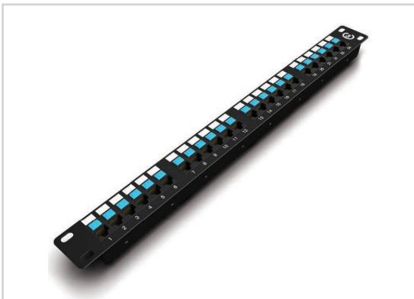
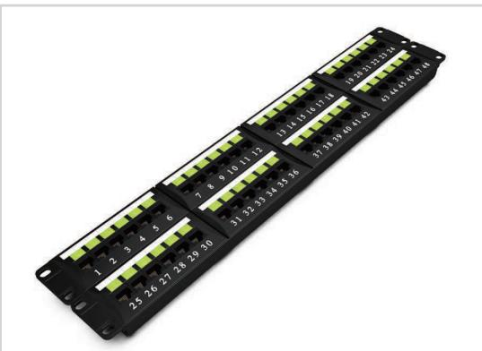
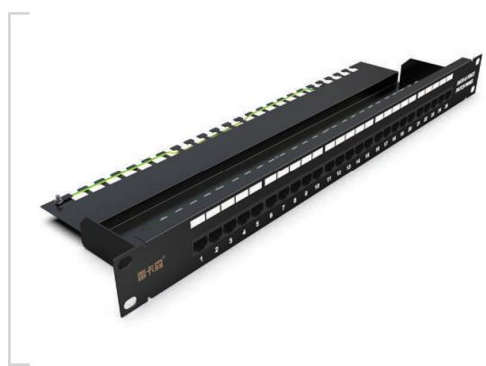
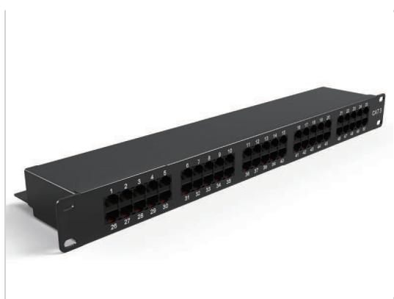
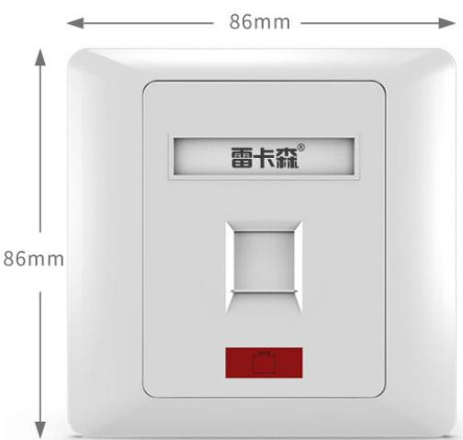
TECHNICAL PRODUCT PORTFOLIO
Patch Panels, Faceplates & Keystone Modules
SP5524
Detailed model selection for overseas B2B projects, system integration and procurement
SP5648
SP6025
TECHNICAL DATA
MODEL SELECTION
PROJECT RFQ
10
4
11
catalog models
product families
application contexts
SP6050
SP8601
Notes:
[Sources]
- D:\Nexpro-link 产品数据库\artifacts\NPL-DB-0203\product-artifact-manifest.json
- D:\NexPro-Link-安放解决方案供应商网站\public\images\products\pdu-catalog\patch-data\sp5524\102_sp5524_product.jpg
- D:\NexPro-Link-安放解决方案供应商网站\public\images\products\pdu-catalog\patch-data\sp5648\104_sp5648_product.jpg
- D:\NexPro-Link-安放解决方案供应商网站\public\images\products\pdu-catalog\patch-voice\sp6025\103_sp6025_product.jpg
- D:\NexPro-Link-安放解决方案供应商网站\public\images\products\pdu-catalog\patch-voice\sp6050\105_sp6050_product.jpg
- D:\NexPro-Link-安放解决方案供应商网站\public\images\products\pdu-catalog\faceplate\sp8601\106_sp8601_product.jpg

Slide 2
PATCH PANELS, FACEPLATES & KEYSTONE MODULES
Application landscape
SP5524
SP5648
SP6025
Data patching
Network cabinets
ELV cabling projects
Voice cabling
Telecom rooms
Structured cabling racks
Office network outlets
Wall-mounted data points
Keystone module installation
Patch panels and faceplates
Voice and data cabling
NexPro Product Intelligence · Project configurations are confirmed through RFQ
02
Notes:
[Sources]
- D:\Nexpro-link 产品数据库\artifacts\NPL-DB-0203\product-artifact-manifest.json
- D:\NexPro-Link-安放解决方案供应商网站\public\images\products\pdu-catalog\patch-data\sp5524\102_sp5524_product.jpg
- D:\NexPro-Link-安放解决方案供应商网站\public\images\products\pdu-catalog\patch-data\sp5648\104_sp5648_product.jpg
- D:\NexPro-Link-安放解决方案供应商网站\public\images\products\pdu-catalog\patch-voice\sp6025\103_sp6025_product.jpg

Slide 3
PATCH PANELS, FACEPLATES & KEYSTONE MODULES
Portfolio structure
Data Patch Panel Series
Voice Patch Panel Series
86-Type Information Faceplate Series
2 models
SP5524 · SP5648
2 models
SP6025 · SP6050
3 models
SP8601 · SP8602
Network & Voice Keystone Module Series
3 models
DT968MX · SP739
NexPro Product Intelligence · Project configurations are confirmed through RFQ
03
Notes:
[Sources]
- D:\Nexpro-link 产品数据库\artifacts\NPL-DB-0203\product-artifact-manifest.json

Slide 4
PATCH PANELS, FACEPLATES & KEYSTONE MODULES
Technical data · SP5524 · 1/1
PARAMETER
APPROVED SPECIFICATION
Specification
Cat5e 24 ports
Material
Cold-rolled steel
Application
Connect network equipment and route data cabling
Height
1U
Dimensions
483 × 44.5 × 86 mm (including cable-management rings)
Product series
Data Patch Panel Series
Product category
Patch Panel
SP5524
SP5524 Cat5e 24-port data patch panel
Approved parameters 1–7 of 7
This product section contains every approved customer-facing specification field for the exact model. Missing source values are stated explicitly.
NexPro Product Intelligence · Project configurations are confirmed through RFQ
04
Notes:
[Sources]
- D:\Nexpro-link 产品数据库\artifacts\NPL-DB-0203\product-artifact-manifest.json
- D:\NexPro-Link-安放解决方案供应商网站\src\data\products.ts
- D:\NexPro-Link-安放解决方案供应商网站\public\images\products\pdu-catalog\patch-data\sp5524\102_sp5524_product.jpg

Slide 5
PATCH PANELS, FACEPLATES & KEYSTONE MODULES
Technical data · SP5648 · 1/1
PARAMETER
APPROVED SPECIFICATION
Specification
Cat6 48 ports
Material
Cold-rolled steel
Application
Connect network equipment and route data cabling
Height
2U
Dimensions
483 × 88 × 92 mm (including cable-management rings)
Product series
Data Patch Panel Series
Product category
Patch Panel
SP5648
SP5648 Cat6 48-port data patch panel
Approved parameters 1–7 of 7
This product section contains every approved customer-facing specification field for the exact model. Missing source values are stated explicitly.
NexPro Product Intelligence · Project configurations are confirmed through RFQ
05
Notes:
[Sources]
- D:\Nexpro-link 产品数据库\artifacts\NPL-DB-0203\product-artifact-manifest.json
- D:\NexPro-Link-安放解决方案供应商网站\src\data\products.ts
- D:\NexPro-Link-安放解决方案供应商网站\public\images\products\pdu-catalog\patch-data\sp5648\104_sp5648_product.jpg

Slide 6
PATCH PANELS, FACEPLATES & KEYSTONE MODULES
Technical data · SP6025 · 1/1
PARAMETER
APPROVED SPECIFICATION
Specification
Cat3 25 portsvoice patch panel
Material
Cold-rolled steel
Application
Connect voice equipment and distribute voice circuits
Height
1U
Dimensions
483 × 44.5 × 132 mm
Product series
Voice Patch Panel Series
Product category
Patch Panel
SP6025
SP6025 Cat3 25-port voice patch panel
Approved parameters 1–7 of 7
This product section contains every approved customer-facing specification field for the exact model. Missing source values are stated explicitly.
NexPro Product Intelligence · Project configurations are confirmed through RFQ
06
Notes:
[Sources]
- D:\Nexpro-link 产品数据库\artifacts\NPL-DB-0203\product-artifact-manifest.json
- D:\NexPro-Link-安放解决方案供应商网站\src\data\products.ts
- D:\NexPro-Link-安放解决方案供应商网站\public\images\products\pdu-catalog\patch-voice\sp6025\103_sp6025_product.jpg

Slide 7
PATCH PANELS, FACEPLATES & KEYSTONE MODULES
Technical data · SP6050 · 1/1
PARAMETER
APPROVED SPECIFICATION
Specification
Cat3 50 portsvoice patch panel
Material
Cold-rolled steel
Application
Connect voice equipment and distribute voice circuits
Height
1U
Dimensions
483 × 44.5 × 112 mm
Product series
Voice Patch Panel Series
Product category
Patch Panel
SP6050
SP6050 Cat3 50-port voice patch panel
Approved parameters 1–7 of 7
This product section contains every approved customer-facing specification field for the exact model. Missing source values are stated explicitly.
NexPro Product Intelligence · Project configurations are confirmed through RFQ
07
Notes:
[Sources]
- D:\Nexpro-link 产品数据库\artifacts\NPL-DB-0203\product-artifact-manifest.json
- D:\NexPro-Link-安放解决方案供应商网站\src\data\products.ts
- D:\NexPro-Link-安放解决方案供应商网站\public\images\products\pdu-catalog\patch-voice\sp6050\105_sp6050_product.jpg

Slide 8
PATCH PANELS, FACEPLATES & KEYSTONE MODULES
Technical data · SP8601 · 1/1
PARAMETER
APPROVED SPECIFICATION
Specification
1-port faceplate
Material
Flame-retardant PC
Application Environment
Home, internet cafe, office and similar installations
Dimensions
86 × 86 mm
Mounting Hole Spacing
60 mm
Product series
86-Type Information Faceplate Series
Product category
Structured Cabling Accessory
SP8601
SP8601 86-Type 1-Port Network Faceplate
Approved parameters 1–7 of 7
This product section contains every approved customer-facing specification field for the exact model. Missing source values are stated explicitly.
NexPro Product Intelligence · Project configurations are confirmed through RFQ
08
Notes:
[Sources]
- D:\Nexpro-link 产品数据库\artifacts\NPL-DB-0203\product-artifact-manifest.json
- D:\NexPro-Link-安放解决方案供应商网站\src\data\products.ts
- D:\NexPro-Link-安放解决方案供应商网站\public\images\products\pdu-catalog\faceplate\sp8601\106_sp8601_product.jpg

Slide 9
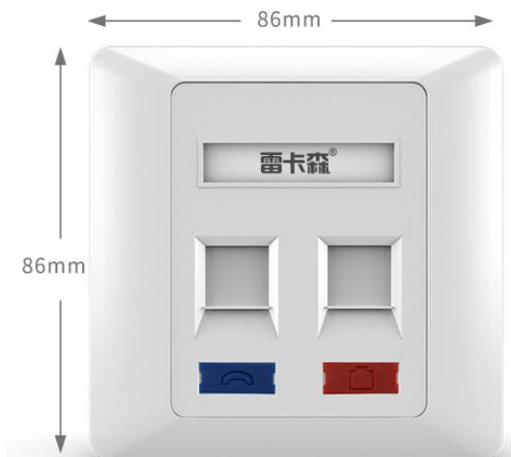
PATCH PANELS, FACEPLATES & KEYSTONE MODULES
Technical data · SP8602 · 1/1
PARAMETER
APPROVED SPECIFICATION
Specification
2-port faceplate
Material
Flame-retardant PC
Application Environment
Home, internet cafe, office and similar installations
Dimensions
86 × 86 mm
Mounting Hole Spacing
60 mm
Product series
86-Type Information Faceplate Series
Product category
Structured Cabling Accessory
SP8602
SP8602 86-Type 2-Port Network Faceplate
Approved parameters 1–7 of 7
This product section contains every approved customer-facing specification field for the exact model. Missing source values are stated explicitly.
NexPro Product Intelligence · Project configurations are confirmed through RFQ
09
Notes:
[Sources]
- D:\Nexpro-link 产品数据库\artifacts\NPL-DB-0203\product-artifact-manifest.json
- D:\NexPro-Link-安放解决方案供应商网站\src\data\products.ts
- D:\NexPro-Link-安放解决方案供应商网站\public\images\products\pdu-catalog\faceplate\sp8602\107_sp8602_product.jpg

Slide 10
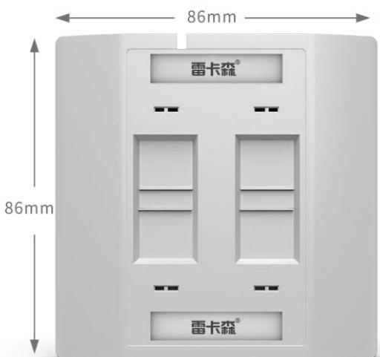
PATCH PANELS, FACEPLATES & KEYSTONE MODULES
Technical data · SP8604 · 1/1
PARAMETER
APPROVED SPECIFICATION
Specification
4-port faceplate
Material
Flame-retardant PC
Application Environment
Home, internet cafe, office and similar installations
Dimensions
86 × 86 mm
Mounting Hole Spacing
60 mm
Product series
86-Type Information Faceplate Series
Product category
Structured Cabling Accessory
SP8604
SP8604 86-Type 4-Port Network Faceplate
Approved parameters 1–7 of 7
This product section contains every approved customer-facing specification field for the exact model. Missing source values are stated explicitly.
NexPro Product Intelligence · Project configurations are confirmed through RFQ
10
Notes:
[Sources]
- D:\Nexpro-link 产品数据库\artifacts\NPL-DB-0203\product-artifact-manifest.json
- D:\NexPro-Link-安放解决方案供应商网站\src\data\products.ts
- D:\NexPro-Link-安放解决方案供应商网站\public\images\products\pdu-catalog\faceplate\sp8604\109_sp8604_product.jpg

Slide 11
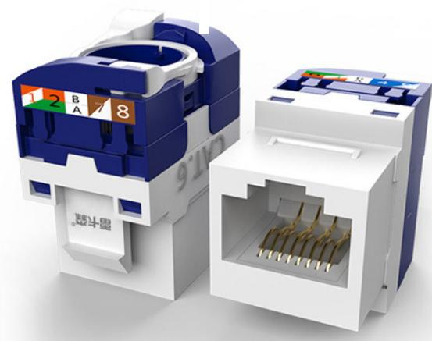
PATCH PANELS, FACEPLATES & KEYSTONE MODULES
Technical data · DT968MX · 1/1
PARAMETER
APPROVED SPECIFICATION
Product
Network module
Type
Class VI / Cat6 module
Material
Impact-resistant ABS
Features
Tool-free / feed-through (catalog wording normalized)
Application
Connection module between faceplate and network cable
Product series
Network & Voice Keystone Module Series
Product category
Structured Cabling Accessory
DT968MX
DT968MX Cat6 Tool-Free Network Module
Approved parameters 1–7 of 7
This product section contains every approved customer-facing specification field for the exact model. Missing source values are stated explicitly.
NexPro Product Intelligence · Project configurations are confirmed through RFQ
11
Notes:
[Sources]
- D:\Nexpro-link 产品数据库\artifacts\NPL-DB-0203\product-artifact-manifest.json
- D:\NexPro-Link-安放解决方案供应商网站\src\data\products.ts
- D:\NexPro-Link-安放解决方案供应商网站\public\images\products\pdu-catalog\modules\dt968mx\111_dt968mx_product.jpg

Slide 12
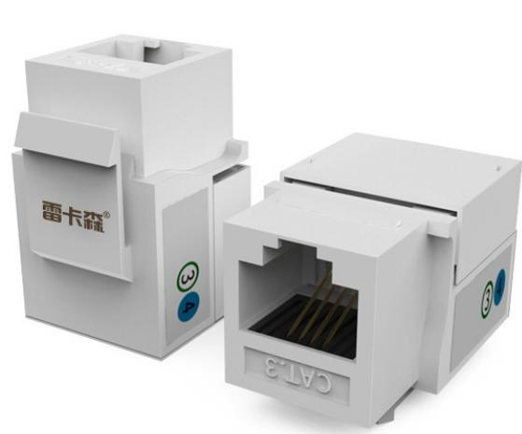
PATCH PANELS, FACEPLATES & KEYSTONE MODULES
Technical data · SP739 · 1/1
PARAMETER
APPROVED SPECIFICATION
Product
Network / voice module
Type
CAT3 voice/telephone module
Material
Impact-resistant ABS
Features
90° punch-down / labeling
Application
Connection module between terminal equipment and network/telephone cable
Product series
Network & Voice Keystone Module Series
Product category
Structured Cabling Accessory
SP739
SP739 CA T3 90° voice/telephone module
Approved parameters 1–7 of 7
This product section contains every approved customer-facing specification field for the exact model. Missing source values are stated explicitly.
NexPro Product Intelligence · Project configurations are confirmed through RFQ
12
Notes:
[Sources]
- D:\Nexpro-link 产品数据库\artifacts\NPL-DB-0203\product-artifact-manifest.json
- D:\NexPro-Link-安放解决方案供应商网站\src\data\products.ts
- D:\NexPro-Link-安放解决方案供应商网站\public\images\products\pdu-catalog\modules\sp739\108_sp739_product.jpg

Slide 13
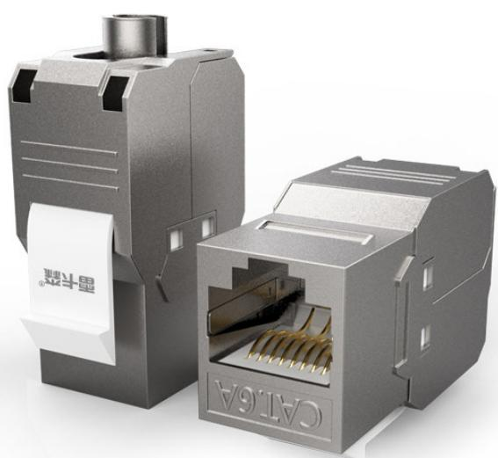
PATCH PANELS, FACEPLATES & KEYSTONE MODULES
Technical data · SP868P · 1/1
PARAMETER
APPROVED SPECIFICATION
Product
Network module
Type
Class VI / Cat6 module
Material
Metal
Features
Shielded, tool-free / feed-through
Application
Connection module between faceplate and network cable
Product series
Network & Voice Keystone Module Series
Product category
Structured Cabling Accessory
SP868P
SP868P Cat6 Shielded Tool-Free Module
Approved parameters 1–7 of 7
This product section contains every approved customer-facing specification field for the exact model. Missing source values are stated explicitly.
NexPro Product Intelligence · Project configurations are confirmed through RFQ
13
Notes:
[Sources]
- D:\Nexpro-link 产品数据库\artifacts\NPL-DB-0203\product-artifact-manifest.json
- D:\NexPro-Link-安放解决方案供应商网站\src\data\products.ts
- D:\NexPro-Link-安放解决方案供应商网站\public\images\products\pdu-catalog\modules\sp868p\110_sp868p_product.jpg

Slide 14
PATCH PANELS, FACEPLATES & KEYSTONE MODULES
Technical selection snapshot
Exact model
SP5524
SP6050
SP8604
SP868P
Product
SP5524 Cat5e 24-port data patch panel
SP6050 Cat3 50-port voice patch panel
SP8604 86-Type 4-Port Network Faceplate
SP868P Cat6 Shielded Tool-Free Module
Key specification 1
Specification: Cat5e 24 ports
Specification: Cat3 50 portsvoice patch panel
Specification: 4-port faceplate
Product: Network module
Key specification 2
Material: Cold-rolled steel
Material: Cold-rolled steel
Material: Flame-retardant PC
Type: Class VI / Cat6 module
Application fit
Data patching · Network cabinets · ELV cabling projec…
Voice cabling · Telecom rooms · Structured cabling ra…
Office network outlets · ELV cabling projects · Wall-…
Keystone module installation · Patch panels and facep…
Use the detailed Word specification documents for complete approved attributes and family variant tables.
NexPro Product Intelligence · Project configurations are confirmed through RFQ
14
Notes:
[Sources]
- D:\Nexpro-link 产品数据库\artifacts\NPL-DB-0203\product-artifact-manifest.json

Slide 15
PATCH PANELS, FACEPLATES & KEYSTONE MODULES
Approved model register
SP5524
SP5648
SP6025
SP6050
SP8601
SP8602
SP8604
DT968MX
SP739
SP868P
10 exact website model records shown on this page · 10 total for this product line
NexPro Product Intelligence · Project configurations are confirmed through RFQ
15
Notes:
[Sources]
- D:\Nexpro-link 产品数据库\artifacts\NPL-DB-0203\product-artifact-manifest.json
- D:\NexPro-Link-安放解决方案供应商网站\src\data\products.ts

Slide 16
PATCH PANELS, FACEPLATES & KEYSTONE MODULES
Procurement and RFQ checklist
01
Quantity & mix
Confirm by model and project quantity
Include in your inquiry
02
Lead time
Confirm after configuration review
Exact model or required function
Estimated quantity
Destination country or port
Required interfaces / accessories
Documentation and OEM/ODM needs
03
Shipping basis
Confirm in project quotation
04
OEM / ODM
To be confirmed
Final configuration, availability and commercial terms are confirmed in the project quotation.
NexPro Product Intelligence · Project configurations are confirmed through RFQ
16
Notes:
[Sources]
- D:\Nexpro-link 产品数据库\artifacts\NPL-DB-0203\product-artifact-manifest.json

Slide 17
READY FOR THE PROJECT LIST
Share your requirements.
We will shortlist the right models.
Patch Panels, Faceplates & Keystone Modules
REQUEST A PROJECT QUOTATION
NexPro · 17
Notes:
[Sources]
- D:\Nexpro-link 产品数据库\artifacts\NPL-DB-0203\product-artifact-manifest.json
- D:\Nexpro-link 产品数据库\artifacts\NPL-DB-0304\assets\nexpro-technical-background-v1.png

