Slide 1


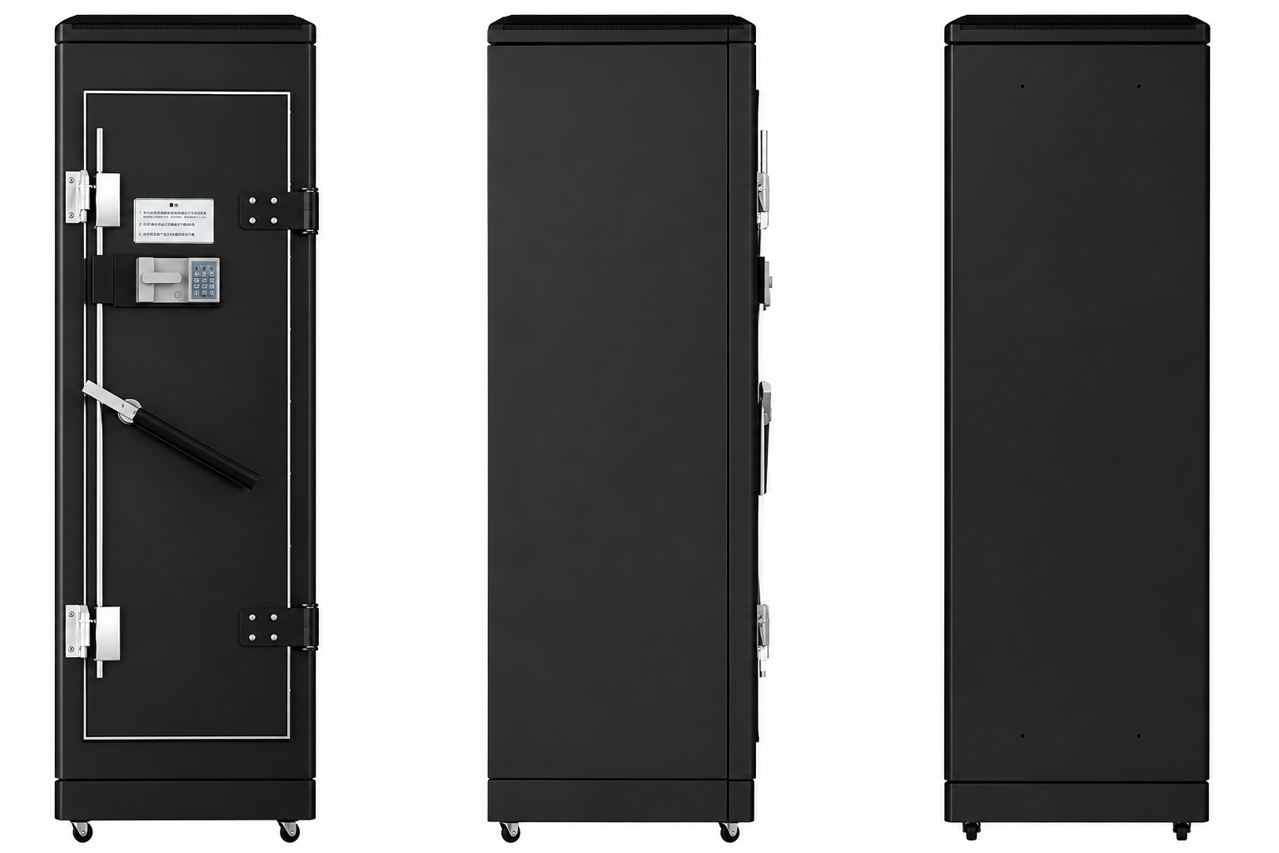
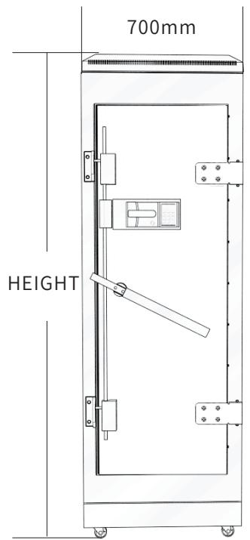
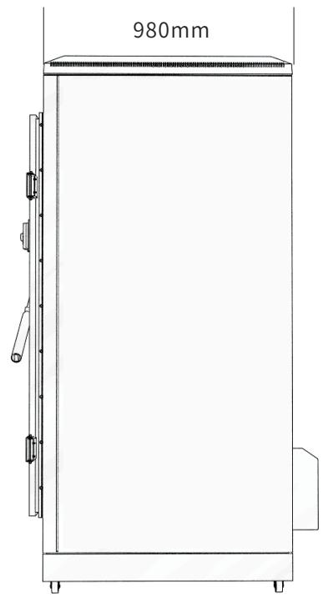
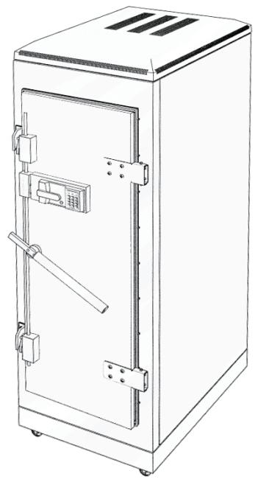
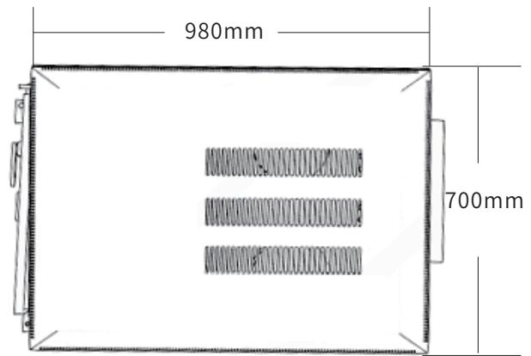
TECHNICAL PRODUCT PORTFOLIO
Rack Cabinets & Data Center Containment
KP-C
Detailed model selection for overseas B2B projects, system integration and procurement
KP-C
KP-C
TECHNICAL DATA
MODEL SELECTION
PROJECT RFQ
12
5
14
catalog models
product families
application contexts
KP-C
KP-C
Notes:
[Sources]
- D:\Nexpro-link 产品数据库\artifacts\NPL-DB-0203\product-artifact-manifest.json
- D:\NexPro-Link-安放解决方案供应商网站\public\images\products\pdu-catalog\shielding\kp-c-71010\056_shielding_cabinet_product.png
- D:\NexPro-Link-安放解决方案供应商网站\public\images\products\pdu-catalog\shielding\kp-c-71010\060_shielding_front_drawing.jpg
- D:\NexPro-Link-安放解决方案供应商网站\public\images\products\pdu-catalog\shielding\kp-c-71010\061_shielding_side_drawing.jpg
- D:\NexPro-Link-安放解决方案供应商网站\public\images\products\pdu-catalog\shielding\kp-c-71010\062_shielding_3d_drawing.jpg
- D:\NexPro-Link-安放解决方案供应商网站\public\images\products\pdu-catalog\shielding\kp-c-71010\063_shielding_top_drawing.jpg

Slide 2
RACK CABINETS & DATA CENTER CONTAINMENT
Application landscape
KP-C
KP-C
KP-C
EMI-sensitive equipment rooms
Data rooms
Security and communication cabinets
Data centers
Server rooms
Energy-efficiency retrofit projects
Wall-mount network cabinets
CCTV and ELV equipment racks
Small server rooms
Network rooms
ELV equipment cabinets
Structured cabling racks
NexPro Product Intelligence · Project configurations are confirmed through RFQ
02
Notes:
[Sources]
- D:\Nexpro-link 产品数据库\artifacts\NPL-DB-0203\product-artifact-manifest.json
- D:\NexPro-Link-安放解决方案供应商网站\public\images\products\pdu-catalog\shielding\kp-c-71010\056_shielding_cabinet_product.png
- D:\NexPro-Link-安放解决方案供应商网站\public\images\products\pdu-catalog\shielding\kp-c-71010\060_shielding_front_drawing.jpg
- D:\NexPro-Link-安放解决方案供应商网站\public\images\products\pdu-catalog\shielding\kp-c-71010\061_shielding_side_drawing.jpg

Slide 3
RACK CABINETS & DATA CENTER CONTAINMENT
Portfolio structure
KP-C Electromagnetic Shielding Cabinet Series
Custom Cold Aisle Containment Series / Manufacturer Model Not Provided
K1 Network & Server Cabinet Series
1 model
KP-C
1 model
COLD-AISLE-CUSTOM
5 models
K1-5006 · K1-5012
K2 Network Cabinet Series
K5 Heavy-Duty Server Cabinet Series
2 models
K2-6620 · K2-6622
3 models
K5-6042 · K5-61242
NexPro Product Intelligence · Project configurations are confirmed through RFQ
03
Notes:
[Sources]
- D:\Nexpro-link 产品数据库\artifacts\NPL-DB-0203\product-artifact-manifest.json

Slide 4
RACK CABINETS & DATA CENTER CONTAINMENT
Technical data · KP-C · 1/1
PARAMETER
APPROVED SPECIFICATION
Configurations
14
Rack Height
10U
Net Weight
100kg
Overall Dimensions
700 × 980 × 800 mm
Standard Configuration
10 network-cable waveguides; 5 fiber waveguides; 1 × 16 A filter; 2–3 shelves; 1 × 16 A 6-outlet PDU; 4 adjustable fans; 2 ventilation waveguide windows (catalog: 300 × 30 type)
Optional Configuration
Humidity monitoring, alarm display, combination lock, fingerprint access, four fan groups / high-power fans, waveguide window, opening rear door, air-conditioner extension, air duct, top cable entry, filter, PDU and other options
Product series
KP-C Electromagnetic Shielding Cabinet Series
Entity type
Product group with selectable configurations
KP-C
KP-C Electromagnetic Shielding Cabinet Series
Approved parameters 1–8 of 8
This product section contains every approved customer-facing specification field for the exact model. Missing source values are stated explicitly.
NexPro Product Intelligence · Project configurations are confirmed through RFQ
04
Notes:
[Sources]
- D:\Nexpro-link 产品数据库\artifacts\NPL-DB-0203\product-artifact-manifest.json
- D:\NexPro-Link-安放解决方案供应商网站\src\data\products.ts
- D:\NexPro-Link-安放解决方案供应商网站\public\images\products\pdu-catalog\shielding\kp-c-71010\056_shielding_cabinet_product.png

Slide 5
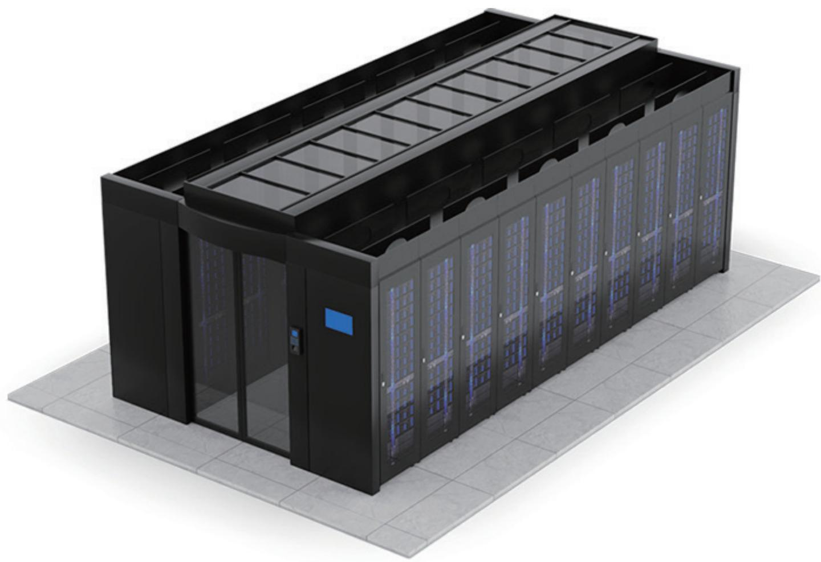
RACK CABINETS & DATA CENTER CONTAINMENT
Technical data · COLD-AISLE-CUSTOM · 1/1
PARAMETER
APPROVED SPECIFICATION
Catalog Dimension Reference
Catalog illustration: aisle width approx. 700 mm; cabinet-row/module depth approx. 980 mm
Structure
Single-row or dual-row modular enclosed aisle
End Door
High-transparency tempered-glass end door; hinged or sliding configuration
Roof
High-transparency roof skylight
Airflow
Perforated cabinet doors support aisle airflow
System Integration
Can integrate with the data-room fire protection system
Expansion
Interfaces reserved for cameras, temperature detection and other modules
Product series
Data Center Cold Aisle Containment System
COLD-AISLE-CUSTOM
Product category
Cold Aisle Containment
Custom Cold Aisle Containment Series / Manufacturer Model Not Provided
Approved parameters 1–9 of 9
This product section contains every approved customer-facing specification field for the exact model. Missing source values are stated explicitly.
NexPro Product Intelligence · Project configurations are confirmed through RFQ
05
Notes:
[Sources]
- D:\Nexpro-link 产品数据库\artifacts\NPL-DB-0203\product-artifact-manifest.json
- D:\NexPro-Link-安放解决方案供应商网站\src\data\products.ts
- D:\NexPro-Link-安放解决方案供应商网站\public\images\products\pdu-catalog\cold-aisle\cold-aisle-custom\069_cold_aisle_system.jpg

Slide 6
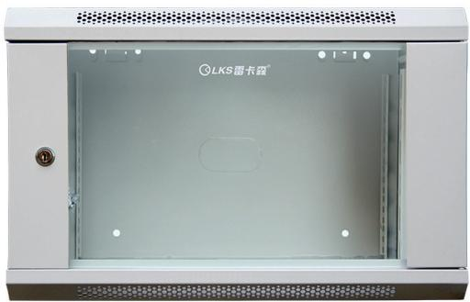
RACK CABINETS & DATA CENTER CONTAINMENT
Technical data · K1-5006 · 1/1
PARAMETER
APPROVED SPECIFICATION
Type
Network cabinet / wall-mount cabinet
Dimensions
350 × 550 × 400 mm
Height
6U
Mounting Rail Spacing
485 mm (19-inch standard)
Sheet Thickness
mounting rails 2.0 mm; other panels 1.0 mm
Material / Finish
SPCC cold-rolled steel, degreased and powder-coated
Series Load Capacity
Wall-mount small-cabinet load rating: ≤50 kg
Standard Configuration
cage nuts and screws × 20、6Umounting rails × 4、glass door × 1、side panels × 2
K1-5006
Recommended Equipment Depth
<300 mm
Product series
K1 Network & Server Cabinet Series
K1-5006 6U wall-mount network cabinet
Product category
Data Center Cabinet
Approved parameters 1–11 of 11
This product section contains every approved customer-facing specification field for the exact model. Missing source values are stated explicitly.
NexPro Product Intelligence · Project configurations are confirmed through RFQ
06
Notes:
[Sources]
- D:\Nexpro-link 产品数据库\artifacts\NPL-DB-0203\product-artifact-manifest.json
- D:\NexPro-Link-安放解决方案供应商网站\src\data\products.ts
- D:\NexPro-Link-安放解决方案供应商网站\public\images\products\pdu-catalog\k1\k1-5006\076_k1_5006_product.jpg

Slide 7
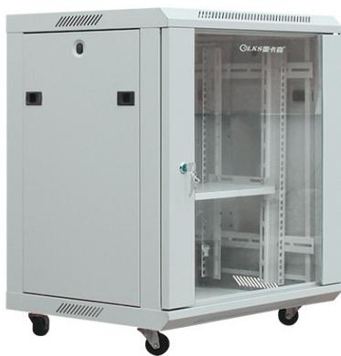
RACK CABINETS & DATA CENTER CONTAINMENT
Technical data · K1-5012 · 1/1
PARAMETER
APPROVED SPECIFICATION
Type
Network cabinet
Dimensions
450 × 550 × 700 mm
Height
12U
Mounting Rail Spacing
485 mm (19-inch standard)
Sheet Thickness
mounting rails 2.0 mm; other panels 1.0 mm
Material / Finish
SPCC cold-rolled steel, degreased and powder-coated
Series Load Capacity
Small-cabinet catalog load rating: ≤50 kg
Standard Configuration
cage nuts and screws × 20、12Umounting rails × 4、glass door × 1、side panels × 2、shelves × 1、casters × 4
K1-5012
Recommended Equipment Depth
<350 mm
Product series
K1 Network & Server Cabinet Series
K1-5012 12U Compact Network Cabinet
Product category
Data Center Cabinet
Approved parameters 1–11 of 11
This product section contains every approved customer-facing specification field for the exact model. Missing source values are stated explicitly.
NexPro Product Intelligence · Project configurations are confirmed through RFQ
07
Notes:
[Sources]
- D:\Nexpro-link 产品数据库\artifacts\NPL-DB-0203\product-artifact-manifest.json
- D:\NexPro-Link-安放解决方案供应商网站\src\data\products.ts
- D:\NexPro-Link-安放解决方案供应商网站\public\images\products\pdu-catalog\k1\k1-5012\078_k1_5012_product.jpg

Slide 8
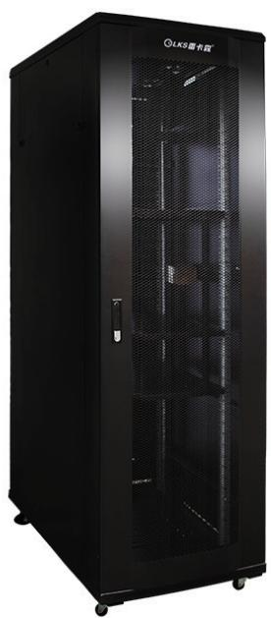
RACK CABINETS & DATA CENTER CONTAINMENT
Technical data · K1-6042 · 1/1
PARAMETER
APPROVED SPECIFICATION
Type
Server cabinet
Dimensions
600 × 1000 × 2000 mm
Height
42U
Mounting Rail Spacing
485 mm (19-inch standard)
Sheet Thickness
mounting rails 2.0 mm; other / main load-bearing beam approx. 1.1±0.1 mm
Material / Finish
SPCC cold-rolled steel, degreased and powder-coated
Series Load Capacity
K1 series catalog load rating: ≤600 kg
Standard Configuration
PDU × 1、cage nuts and screws × 20、M12leveling feet × 4、42Umounting rails × 4、front and rear mesh doors × 1、side panels × 2、fans × 2、shelves × 3、casters × 4
K1-6042
Recommended Equipment Depth
<850 mm
Product series
K1 Network & Server Cabinet Series
K1-6042 42U K1 server cabinet
Product category
Data Center Cabinet
Approved parameters 1–11 of 11
This product section contains every approved customer-facing specification field for the exact model. Missing source values are stated explicitly.
NexPro Product Intelligence · Project configurations are confirmed through RFQ
08
Notes:
[Sources]
- D:\Nexpro-link 产品数据库\artifacts\NPL-DB-0203\product-artifact-manifest.json
- D:\NexPro-Link-安放解决方案供应商网站\src\data\products.ts
- D:\NexPro-Link-安放解决方案供应商网站\public\images\products\pdu-catalog\k1\k1-6042\072_k1_6042_product.jpg

Slide 9
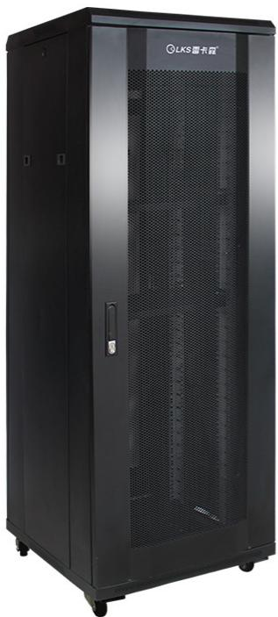
RACK CABINETS & DATA CENTER CONTAINMENT
Technical data · K1-6638 · 1/1
PARAMETER
APPROVED SPECIFICATION
Type
Network cabinet
Dimensions
600 × 600 × 1800 mm
Height
38U
Mounting Rail Spacing
485 mm (19-inch standard)
Sheet Thickness
mounting rails 2.0 mm; other panels 1.1 mm
Material / Finish
SPCC cold-rolled steel, degreased and powder-coated
Series Load Capacity
≤600kg
Standard Configuration
PDU × 1、cage nuts and screws × 20、M12leveling feet × 4、38Umounting rails × 4、front and rear mesh doors × 1、side panels × 2、fans × 1、shelves × 3、casters × 4
K1-6638
Recommended Equipment Depth
<450 mm
Product series
K1 Network & Server Cabinet Series
K1-6638 38U K1 network cabinet
Product category
Data Center Cabinet
Approved parameters 1–11 of 11
This product section contains every approved customer-facing specification field for the exact model. Missing source values are stated explicitly.
NexPro Product Intelligence · Project configurations are confirmed through RFQ
09
Notes:
[Sources]
- D:\Nexpro-link 产品数据库\artifacts\NPL-DB-0203\product-artifact-manifest.json
- D:\NexPro-Link-安放解决方案供应商网站\src\data\products.ts
- D:\NexPro-Link-安放解决方案供应商网站\public\images\products\pdu-catalog\k1\k1-6638\080_k1_6638_product.jpg

Slide 10
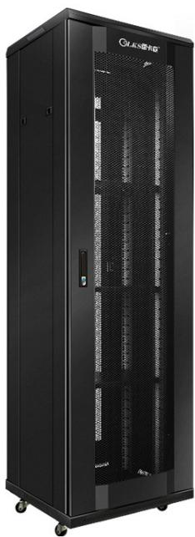
RACK CABINETS & DATA CENTER CONTAINMENT
Technical data · K1-6642 · 1/1
PARAMETER
APPROVED SPECIFICATION
Type
Catalog classification: server cabinet
Dimensions
catalog states 600 × 1000 × 2000 mm
Mounting Rail Spacing
485 mm (19-inch standard)
Sheet Thickness
mounting rails 2.0 mm; main load-bearing beam approx. 1.1±0.1 mm
Material / Finish
SPCC cold-rolled steel, degreased and powder-coated
Standard Configuration
Same catalog specification as K1-6042
Recommended Equipment Depth
<850 mm
Product series
K1 Network & Server Cabinet Series
K1-6642
Product category
Data Center Cabinet
K1-6642 42U K1 Cabinet (Duplicate Catalog Specification)
Approved parameters 1–9 of 9
This product section contains every approved customer-facing specification field for the exact model. Missing source values are stated explicitly.
NexPro Product Intelligence · Project configurations are confirmed through RFQ
10
Notes:
[Sources]
- D:\Nexpro-link 产品数据库\artifacts\NPL-DB-0203\product-artifact-manifest.json
- D:\NexPro-Link-安放解决方案供应商网站\src\data\products.ts
- D:\NexPro-Link-安放解决方案供应商网站\public\images\products\pdu-catalog\k1\k1-6642\074_k1_6642_product.jpg

Slide 11
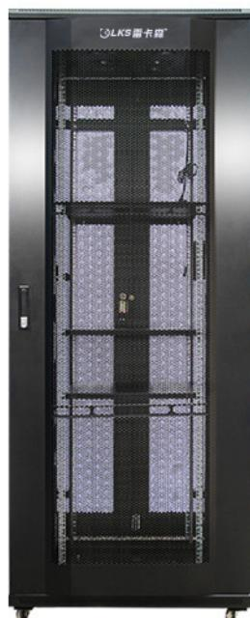
RACK CABINETS & DATA CENTER CONTAINMENT
Technical data · K2-6620 · 1/1
PARAMETER
APPROVED SPECIFICATION
Type
Network cabinet
Dimensions
600 × 600 × 1000 mm
Height
20U
Mounting Rail Spacing
485 mm (19-inch standard)
Sheet Thickness
mounting rails 2.0 mm; other panels 1.0 mm
Material / Finish
SPCC cold-rolled steel, degreased and powder-coated
Series Load Capacity
≤400kg
Standard Configuration
PDU × 1、cage nuts and screws × 20、M12leveling feet × 4、20Umounting rails × 4、front and rear mesh doors × 1、side panels × 2、fans × 1、shelves × 1、casters × 4
K2-6620
Recommended Equipment Depth
<450 mm
Product series
K2 Network Cabinet Series
K2-6620 20U K2 network cabinet
Product category
Data Center Cabinet
Approved parameters 1–11 of 11
This product section contains every approved customer-facing specification field for the exact model. Missing source values are stated explicitly.
NexPro Product Intelligence · Project configurations are confirmed through RFQ
11
Notes:
[Sources]
- D:\Nexpro-link 产品数据库\artifacts\NPL-DB-0203\product-artifact-manifest.json
- D:\NexPro-Link-安放解决方案供应商网站\src\data\products.ts
- D:\NexPro-Link-安放解决方案供应商网站\public\images\products\pdu-catalog\k2\k2-6620\083_k2_6620_product.jpg

Slide 12
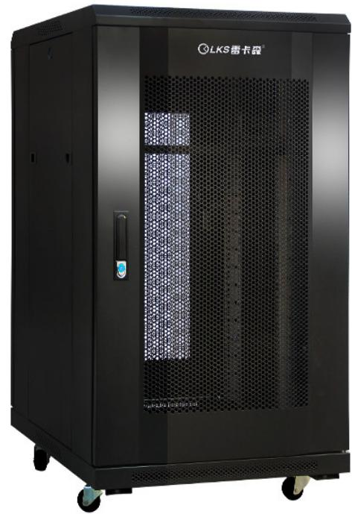
RACK CABINETS & DATA CENTER CONTAINMENT
Technical data · K2-6622 · 1/1
PARAMETER
APPROVED SPECIFICATION
Type
Network cabinet
Dimensions
600 × 600 × 1200 mm
Height
22U
Mounting Rail Spacing
485 mm (19-inch standard)
Sheet Thickness
mounting rails 2.0 mm; other panels 1.0 mm
Material / Finish
SPCC cold-rolled steel, degreased and powder-coated
Series Load Capacity
≤400kg
Standard Configuration
PDU × 1、cage nuts and screws × 20、M12leveling feet × 4、22Umounting rails × 4、front and rear mesh doors × 1、side panels × 2、fans × 1、shelves × 1、casters × 4
K2-6622
Recommended Equipment Depth
<450 mm
Product series
K2 Network Cabinet Series
K2-6622 22U K2 network cabinet
Product category
Data Center Cabinet
Approved parameters 1–11 of 11
This product section contains every approved customer-facing specification field for the exact model. Missing source values are stated explicitly.
NexPro Product Intelligence · Project configurations are confirmed through RFQ
12
Notes:
[Sources]
- D:\Nexpro-link 产品数据库\artifacts\NPL-DB-0203\product-artifact-manifest.json
- D:\NexPro-Link-安放解决方案供应商网站\src\data\products.ts
- D:\NexPro-Link-安放解决方案供应商网站\public\images\products\pdu-catalog\k2\k2-6622\084_k2_6622_product.jpg

Slide 13
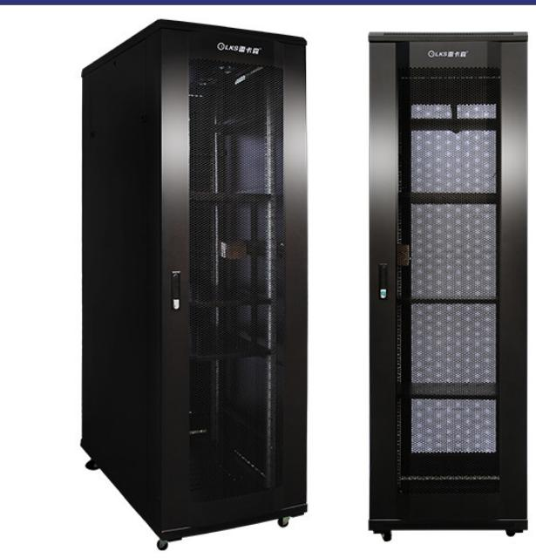
RACK CABINETS & DATA CENTER CONTAINMENT
Technical data · K5-6042 · 1/1
PARAMETER
APPROVED SPECIFICATION
Type
Server cabinet
Dimensions
600 × 1000 × 2000 mm
Height
42U
Mounting Rail Spacing
485 mm (19-inch standard)
Sheet Thickness
mounting rails 2.0 mm; main load-bearing beam 1.5 mm; panels 1.2 mm
Material / Finish
SPCC cold-rolled steel, degreased and powder-coated
Series Load Capacity
Catalog load rating on page 14: ≤1000 kg
Standard Configuration
PDU × 1、cage nuts and screws × 20、M12leveling feet × 4、42Umounting rails × 4、front mesh door × 1、rear double mesh doors × 1、side panels × 2、fans × 4、shelves × 2、casters × 4
K5-6042
Recommended Equipment Depth
<900 mm
Product series
K5 Heavy-Duty Server Cabinet Series
K5-6042 42U Reinforced K5 Server Cabinet
Product category
Data Center Cabinet
Approved parameters 1–11 of 11
This product section contains every approved customer-facing specification field for the exact model. Missing source values are stated explicitly.
NexPro Product Intelligence · Project configurations are confirmed through RFQ
13
Notes:
[Sources]
- D:\Nexpro-link 产品数据库\artifacts\NPL-DB-0203\product-artifact-manifest.json
- D:\NexPro-Link-安放解决方案供应商网站\src\data\products.ts
- D:\NexPro-Link-安放解决方案供应商网站\public\images\products\pdu-catalog\k5\k5-6042\087_k5_6042_product.jpg

Slide 14
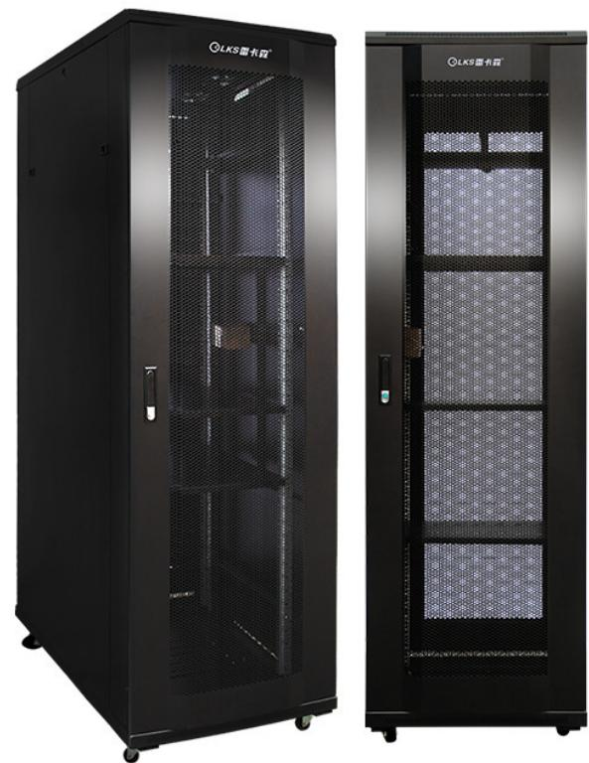
RACK CABINETS & DATA CENTER CONTAINMENT
Technical data · K5-61242 · 1/1
PARAMETER
APPROVED SPECIFICATION
Type
Server cabinet
Dimensions
600 × 1200 × 2000 mm
Height
42U
Mounting Rail Spacing
485 mm (19-inch standard)
Sheet Thickness
mounting rails 2.0 mm; other panels 1.2 mm
Material / Finish
SPCC cold-rolled steel, degreased and powder-coated
Series Load Capacity
K5 series catalog load rating on page 13: ≤700 kg
Standard Configuration
PDU × 1、cage nuts and screws × 20、M12leveling feet × 4、42Umounting rails × 4、front and rear mesh doors × 1、side panels × 2、fans × 4、shelves × 3、casters × 4
K5-61242
Recommended Equipment Depth
<1050 mm
Product series
K5 Heavy-Duty Server Cabinet Series
K5-61242 42U 1200 mm-Deep K5 Server Cabinet
Product category
Data Center Cabinet
Approved parameters 1–11 of 11
This product section contains every approved customer-facing specification field for the exact model. Missing source values are stated explicitly.
NexPro Product Intelligence · Project configurations are confirmed through RFQ
14
Notes:
[Sources]
- D:\Nexpro-link 产品数据库\artifacts\NPL-DB-0203\product-artifact-manifest.json
- D:\NexPro-Link-安放解决方案供应商网站\src\data\products.ts
- D:\NexPro-Link-安放解决方案供应商网站\public\images\products\pdu-catalog\k5\k5-61242\085_k5_61242_product.jpg

Slide 15
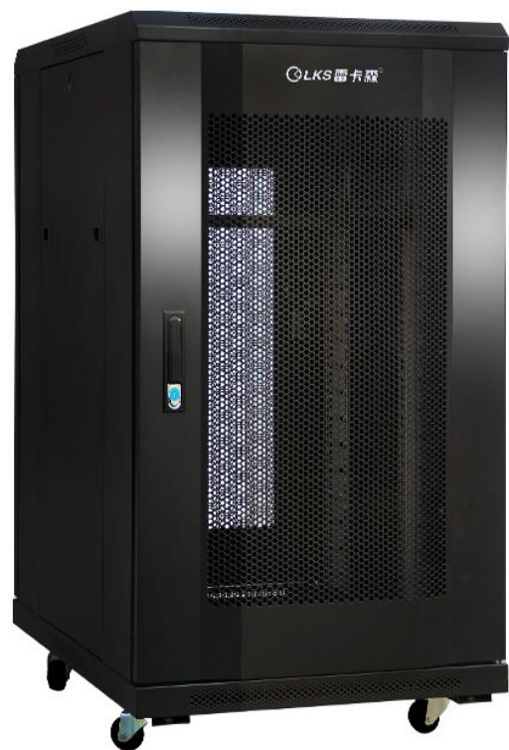
RACK CABINETS & DATA CENTER CONTAINMENT
Technical data · K5-8842 · 1/1
PARAMETER
APPROVED SPECIFICATION
Type
Server cabinet
Dimensions
800 × 800 × 2000 mm
Height
42U
Mounting Rail Spacing
485 mm (19-inch standard)
Sheet Thickness
Product table: mounting rails 2.0 mm and other panels 1.1 mm; series heading: other panels 1.2 mm
Material / Finish
SPCC cold-rolled steel, degreased and powder-coated
Series Load Capacity
≤700kg
Standard Configuration
PDU × 1、cage nuts and screws × 20、M12leveling feet × 4、42Umounting rails × 4、front and rear mesh doors × 1、side panels × 2、fans × 1、shelves × 1、casters × 4、cable channels × 2
K5-8842
Recommended Equipment Depth
<650 mm
Product series
K5 Heavy-Duty Server Cabinet Series
K5-8842 42U 800 × 800 K5 server cabinet
Product category
Data Center Cabinet
Approved parameters 1–11 of 11
This product section contains every approved customer-facing specification field for the exact model. Missing source values are stated explicitly.
NexPro Product Intelligence · Project configurations are confirmed through RFQ
15
Notes:
[Sources]
- D:\Nexpro-link 产品数据库\artifacts\NPL-DB-0203\product-artifact-manifest.json
- D:\NexPro-Link-安放解决方案供应商网站\src\data\products.ts
- D:\NexPro-Link-安放解决方案供应商网站\public\images\products\pdu-catalog\k5\k5-8842\086_k5_8842_product.jpg

Slide 16
RACK CABINETS & DATA CENTER CONTAINMENT
Technical selection snapshot
Exact model
KP-C
K1-6042
K2-6622
K5-8842
Product
KP-C Electromagnetic Shielding Cabinet Series
K1-6042 42U K1 server cabinet
K2-6622 22U K2 network cabinet
K5-8842 42U 800 × 800 K5 server cabinet
Key specification 1
Configurations: 14
Type: Server cabinet
Type: Network cabinet
Type: Server cabinet
Key specification 2
Rack Height: 10U
Dimensions: 600 × 1000 × 2000 mm
Dimensions: 600 × 600 × 1200 mm
Dimensions: 800 × 800 × 2000 mm
Application fit
EMI-sensitive equipment rooms · Data rooms · Security…
Wall-mount network cabinets · CCTV and ELV equipment…
Network rooms · ELV equipment cabinets · Structured c…
Server rooms · Data-room racks · High-load equipment…
Use the detailed Word specification documents for complete approved attributes and family variant tables.
NexPro Product Intelligence · Project configurations are confirmed through RFQ
16
Notes:
[Sources]
- D:\Nexpro-link 产品数据库\artifacts\NPL-DB-0203\product-artifact-manifest.json

Slide 17
RACK CABINETS & DATA CENTER CONTAINMENT
Approved model register
KP-C
COLD-AISLE-CUSTOM
K1-5006
K1-5012
K1-6042
K1-6638
K1-6642
K2-6620
K2-6622
K5-6042
K5-61242
K5-8842
12 exact website model records shown on this page · 12 total for this product line
NexPro Product Intelligence · Project configurations are confirmed through RFQ
17
Notes:
[Sources]
- D:\Nexpro-link 产品数据库\artifacts\NPL-DB-0203\product-artifact-manifest.json
- D:\NexPro-Link-安放解决方案供应商网站\src\data\products.ts

Slide 18
RACK CABINETS & DATA CENTER CONTAINMENT
Procurement and RFQ checklist
01
Quantity & mix
Confirm by model and project quantity
Include in your inquiry
02
Lead time
Confirm after configuration review
Exact model or required function
Estimated quantity
Destination country or port
Required interfaces / accessories
Documentation and OEM/ODM needs
03
Shipping basis
Confirm in project quotation
04
OEM / ODM
To be confirmed
Final configuration, availability and commercial terms are confirmed in the project quotation.
NexPro Product Intelligence · Project configurations are confirmed through RFQ
18
Notes:
[Sources]
- D:\Nexpro-link 产品数据库\artifacts\NPL-DB-0203\product-artifact-manifest.json

Slide 19
READY FOR THE PROJECT LIST
Share your requirements.
We will shortlist the right models.
Rack Cabinets & Data Center Containment
REQUEST A PROJECT QUOTATION
NexPro · 19
Notes:
[Sources]
- D:\Nexpro-link 产品数据库\artifacts\NPL-DB-0203\product-artifact-manifest.json
- D:\Nexpro-link 产品数据库\artifacts\NPL-DB-0304\assets\nexpro-technical-background-v1.png

