Slide 1


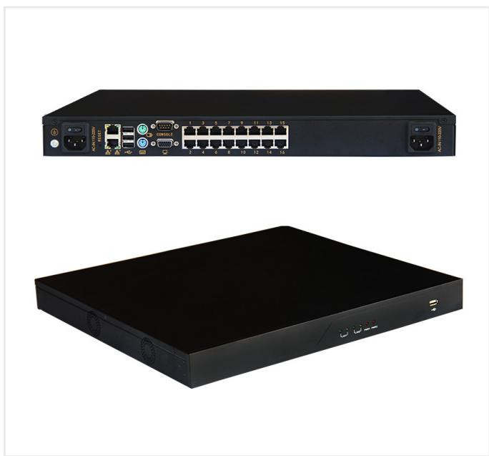
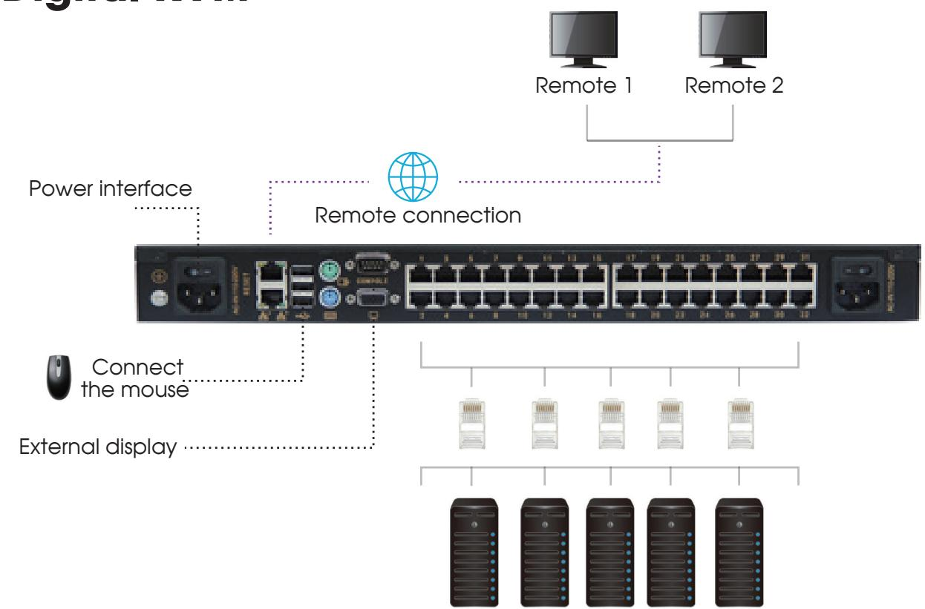
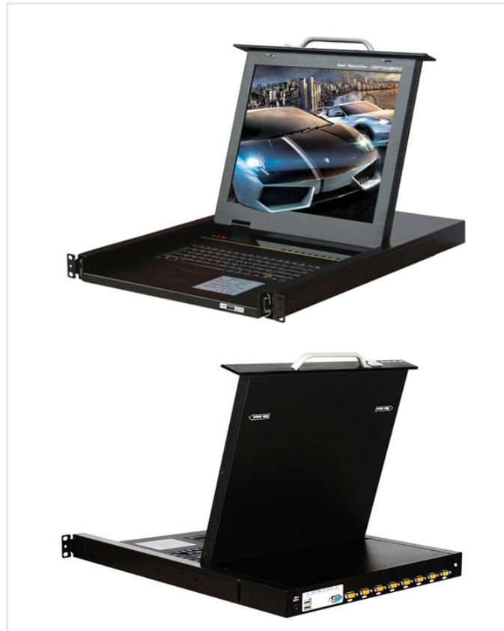
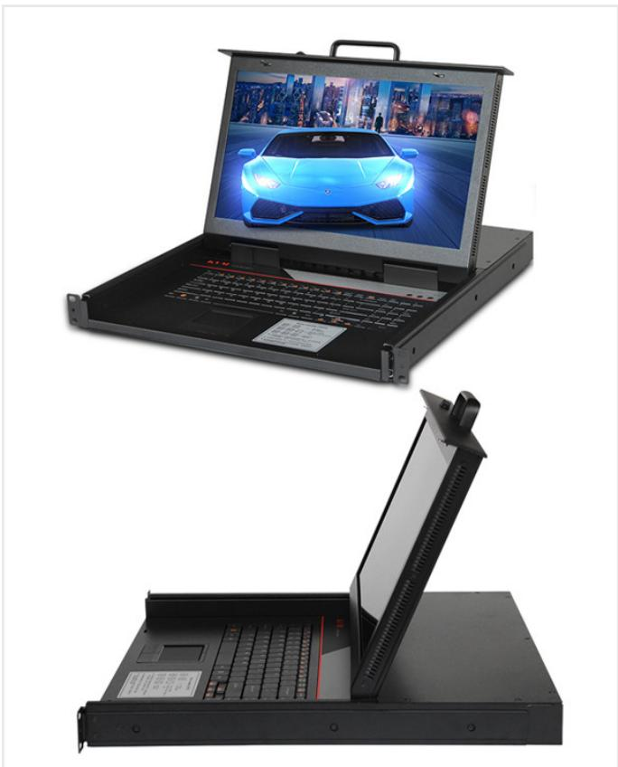
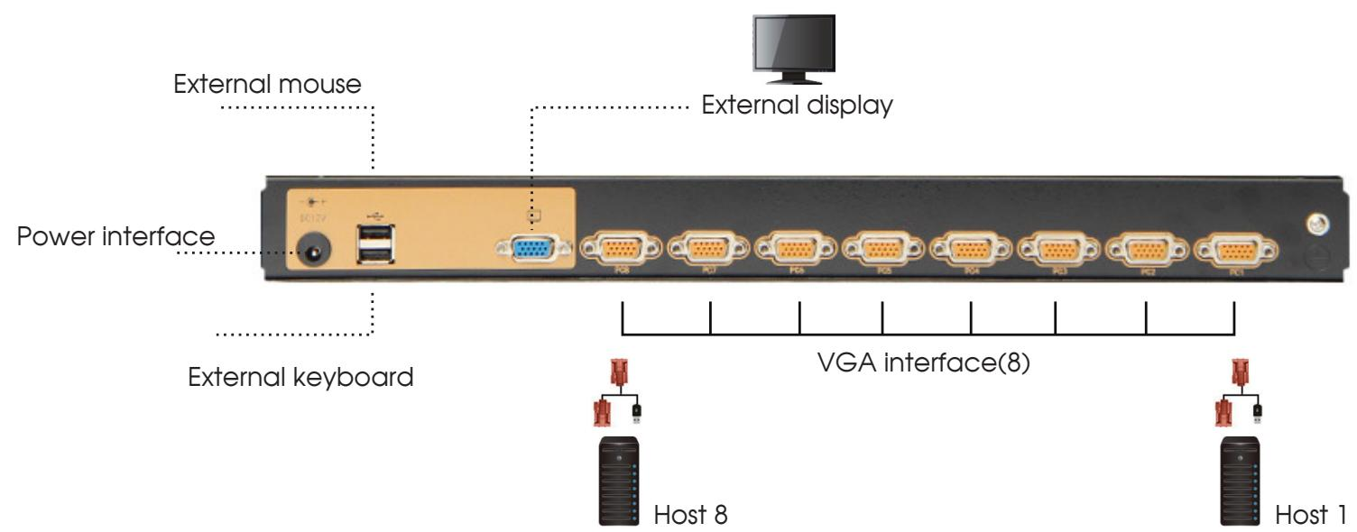
TECHNICAL PRODUCT PORTFOLIO
Rack KVM & Remote Console Management
SP8032
Detailed model selection for overseas B2B projects, system integration and procurement
SP8032
SP1708-B
TECHNICAL DATA
MODEL SELECTION
PROJECT RFQ
7
4
10
catalog models
product families
application contexts
SP1708-B
SP1708-C
Notes:
[Sources]
- D:\Nexpro-link 产品数据库\artifacts\NPL-DB-0203\product-artifact-manifest.json
- D:\NexPro-Link-安放解决方案供应商网站\public\images\products\pdu-catalog\kvm-sp8032\sp8032-l1-r2\090_sp8032_product.jpg
- D:\NexPro-Link-安放解决方案供应商网站\public\images\products\pdu-catalog\kvm-sp8032\sp8032-l1-r2\089_sp8032_diagram.jpg
- D:\NexPro-Link-安放解决方案供应商网站\public\images\products\pdu-catalog\kvm-1708\sp1708-b\092_sp1708_b_product.jpg
- D:\NexPro-Link-安放解决方案供应商网站\public\images\products\pdu-catalog\kvm-1708\sp1708-b\091_sp1708_8port_diagram.jpg
- D:\NexPro-Link-安放解决方案供应商网站\public\images\products\pdu-catalog\kvm-1708\sp1708-c\093_sp1708_c_product.jpg

Slide 2
RACK KVM & REMOTE CONSOLE MANAGEMENT
Application landscape
SP8032
SP8032
SP1708-B
Server rack management
Data center operations
Remote equipment maintenance
Local server management
Data-room racks
Maintenance consoles
Remote server access
Network equipment rooms
High-density server racks
CAT5 KVM extension
NexPro Product Intelligence · Project configurations are confirmed through RFQ
02
Notes:
[Sources]
- D:\Nexpro-link 产品数据库\artifacts\NPL-DB-0203\product-artifact-manifest.json
- D:\NexPro-Link-安放解决方案供应商网站\public\images\products\pdu-catalog\kvm-sp8032\sp8032-l1-r2\090_sp8032_product.jpg
- D:\NexPro-Link-安放解决方案供应商网站\public\images\products\pdu-catalog\kvm-sp8032\sp8032-l1-r2\089_sp8032_diagram.jpg
- D:\NexPro-Link-安放解决方案供应商网站\public\images\products\pdu-catalog\kvm-1708\sp1708-b\092_sp1708_b_product.jpg

Slide 3
RACK KVM & REMOTE CONSOLE MANAGEMENT
Portfolio structure
SP8032 16-Port Digital KVM
SP1708 8-Port Local VGA KVM Series
16-Port Remote IP KVM Series
1 model
SP8032
2 models
SP1708-B · SP1708-C
2 models
SP5716 · SP5916
32-Port CAT5/IP KVM Series
2 models
SP8732 · SP8932
NexPro Product Intelligence · Project configurations are confirmed through RFQ
03
Notes:
[Sources]
- D:\Nexpro-link 产品数据库\artifacts\NPL-DB-0203\product-artifact-manifest.json

Slide 4
RACK KVM & REMOTE CONSOLE MANAGEMENT
Technical data · SP8032 · 1/1
PARAMETER
APPROVED SPECIFICATION
Configurations
2
Server Ports
16
Network Port
RJ45
Resolution
1920 × 1200px
Supported Systems
Windows, Linux, Mac, Sun, etc.
Power
60 W
Dimensions
400 × 440 × 44 mm
Installation
19-inch standard rack cabinet
SP8032
Transmission Distance
50 m
Weight
6.6kg
SP8032 16-Port Digital KVM
User Configuration
1 local user + 2 remote users
Product series
SP8032 16-Port Digital KVM
Approved parameters 1–13 of 13
Entity type
Product group with selectable configurations
This product section contains every approved customer-facing specification field for the exact model. Missing source values are stated explicitly.
NexPro Product Intelligence · Project configurations are confirmed through RFQ
04
Notes:
[Sources]
- D:\Nexpro-link 产品数据库\artifacts\NPL-DB-0203\product-artifact-manifest.json
- D:\NexPro-Link-安放解决方案供应商网站\src\data\products.ts
- D:\NexPro-Link-安放解决方案供应商网站\public\images\products\pdu-catalog\kvm-sp8032\sp8032-l1-r2\090_sp8032_product.jpg

Slide 5
RACK KVM & REMOTE CONSOLE MANAGEMENT
Technical data · SP1708-B · 1/2
PARAMETER
APPROVED SPECIFICATION
Port Count
8
Resolution
1280 × 1024
Dimensions
485 × 570 × 44 mm
Maximum Cascade Capacity
Up to 256 devices (catalog wording: “connections 256”)
I/O Interface
PS/2 / USB dual-interface converter module
Scan Interval
1–255 seconds
System Compatibility
Windows, Vista, Linux, etc.
Power Input
A C100-240V, 50-60Hz, 1 A
SP1708-B
Power Consumption
120V at 23 W; 230V at 25 W
Operating Temperature
0-40℃
SP1708-B 8-port local VGA KVM (1280 × 1024)
Storage Temperature
-20-60℃
Humidity
0-80%RH, non-condensing
Warranty
3 years for main unit; 1 year for display
Approved parameters 1–14 of 15
Product series
SP1708 8-Port Local VGA KVM Series
This product section contains every approved customer-facing specification field for the exact model. Missing source values are stated explicitly.
NexPro Product Intelligence · Project configurations are confirmed through RFQ
05
Notes:
[Sources]
- D:\Nexpro-link 产品数据库\artifacts\NPL-DB-0203\product-artifact-manifest.json
- D:\NexPro-Link-安放解决方案供应商网站\src\data\products.ts
- D:\NexPro-Link-安放解决方案供应商网站\public\images\products\pdu-catalog\kvm-1708\sp1708-b\092_sp1708_b_product.jpg

Slide 6
RACK KVM & REMOTE CONSOLE MANAGEMENT
Technical data · SP1708-B · 2/2
PARAMETER
APPROVED SPECIFICATION
Product category
KVM
SP1708-B
SP1708-B 8-port local VGA KVM (1280 × 1024)
Approved parameters 15–15 of 15
This product section contains every approved customer-facing specification field for the exact model. Missing source values are stated explicitly.
NexPro Product Intelligence · Project configurations are confirmed through RFQ
06
Notes:
[Sources]
- D:\Nexpro-link 产品数据库\artifacts\NPL-DB-0203\product-artifact-manifest.json
- D:\NexPro-Link-安放解决方案供应商网站\src\data\products.ts
- D:\NexPro-Link-安放解决方案供应商网站\public\images\products\pdu-catalog\kvm-1708\sp1708-b\092_sp1708_b_product.jpg

Slide 7
RACK KVM & REMOTE CONSOLE MANAGEMENT
Technical data · SP1708-C · 1/2
PARAMETER
APPROVED SPECIFICATION
Port Count
8
Resolution
1920 × 1080
Dimensions
485 × 480 × 44 mm
Maximum Cascade Capacity
Up to 256 devices (catalog wording: “connections 256”)
I/O Interface
PS/2 / USB dual-interface converter module
Scan Interval
1–255 seconds
System Compatibility
Windows, Vista, Linux, etc.
Power Input
A C100-240V, 50-60Hz, 1 A
SP1708-C
Power Consumption
120V at 23 W; 230V at 25 W
Operating Temperature
0-40℃
SP1708-C 8-port local VGA KVM (1920 × 1080)
Storage Temperature
-20-60℃
Humidity
0-80%RH, non-condensing
Warranty
3 years for main unit; 1 year for display
Approved parameters 1–14 of 15
Product series
SP1708 8-Port Local VGA KVM Series
This product section contains every approved customer-facing specification field for the exact model. Missing source values are stated explicitly.
NexPro Product Intelligence · Project configurations are confirmed through RFQ
07
Notes:
[Sources]
- D:\Nexpro-link 产品数据库\artifacts\NPL-DB-0203\product-artifact-manifest.json
- D:\NexPro-Link-安放解决方案供应商网站\src\data\products.ts
- D:\NexPro-Link-安放解决方案供应商网站\public\images\products\pdu-catalog\kvm-1708\sp1708-c\093_sp1708_c_product.jpg

Slide 8
RACK KVM & REMOTE CONSOLE MANAGEMENT
Technical data · SP1708-C · 2/2
PARAMETER
APPROVED SPECIFICATION
Product category
KVM
SP1708-C
SP1708-C 8-port local VGA KVM (1920 × 1080)
Approved parameters 15–15 of 15
This product section contains every approved customer-facing specification field for the exact model. Missing source values are stated explicitly.
NexPro Product Intelligence · Project configurations are confirmed through RFQ
08
Notes:
[Sources]
- D:\Nexpro-link 产品数据库\artifacts\NPL-DB-0203\product-artifact-manifest.json
- D:\NexPro-Link-安放解决方案供应商网站\src\data\products.ts
- D:\NexPro-Link-安放解决方案供应商网站\public\images\products\pdu-catalog\kvm-1708\sp1708-c\093_sp1708_c_product.jpg

Slide 9
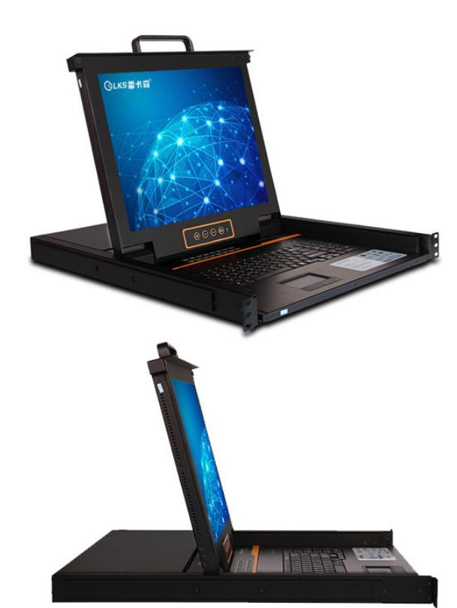
RACK KVM & REMOTE CONSOLE MANAGEMENT
Technical data · SP5716 · 1/2
PARAMETER
APPROVED SPECIFICATION
Port Count
16
Resolution
1280 × 1024
Dimensions
485 × 570 × 44 mm
Maximum Cascade Capacity
Up to 256 devices (catalog wording: “connections 256”)
I/O Interface
PS/2 / USB dual-interface converter module
Scan Interval
1–255 seconds
System Compatibility
Windows, Vista, Linux, etc.
Power Input
A C100-240V, 50-60Hz, 1 A
SP5716
Power Consumption
120V at 23 W; 230V at 25 W
Operating Temperature
0-40℃
SP5716 16-port remote IP KVM
Storage Temperature
-20-60℃
Humidity
0-80%RH, non-condensing
Warranty
3 years for main unit; 1 year for display
Approved parameters 1–14 of 15
Product series
16-Port Remote IP KVM Series
This product section contains every approved customer-facing specification field for the exact model. Missing source values are stated explicitly.
NexPro Product Intelligence · Project configurations are confirmed through RFQ
09
Notes:
[Sources]
- D:\Nexpro-link 产品数据库\artifacts\NPL-DB-0203\product-artifact-manifest.json
- D:\NexPro-Link-安放解决方案供应商网站\src\data\products.ts
- D:\NexPro-Link-安放解决方案供应商网站\public\images\products\pdu-catalog\kvm-ip16\sp5716\095_sp5716_product.jpg

Slide 10
RACK KVM & REMOTE CONSOLE MANAGEMENT
Technical data · SP5716 · 2/2
PARAMETER
APPROVED SPECIFICATION
Product category
KVM
SP5716
SP5716 16-port remote IP KVM
Approved parameters 15–15 of 15
This product section contains every approved customer-facing specification field for the exact model. Missing source values are stated explicitly.
NexPro Product Intelligence · Project configurations are confirmed through RFQ
10
Notes:
[Sources]
- D:\Nexpro-link 产品数据库\artifacts\NPL-DB-0203\product-artifact-manifest.json
- D:\NexPro-Link-安放解决方案供应商网站\src\data\products.ts
- D:\NexPro-Link-安放解决方案供应商网站\public\images\products\pdu-catalog\kvm-ip16\sp5716\095_sp5716_product.jpg

Slide 11
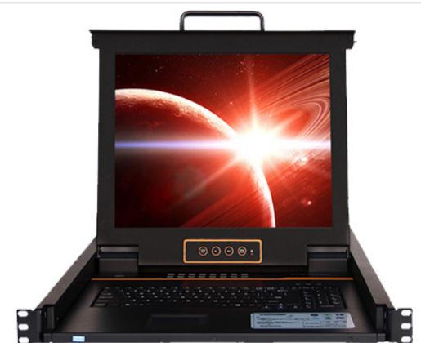
RACK KVM & REMOTE CONSOLE MANAGEMENT
Technical data · SP5916 · 1/2
PARAMETER
APPROVED SPECIFICATION
Port Count
16
Resolution
1280 × 1024
Dimensions
485 × 600 × 44 mm
Maximum Cascade Capacity
Up to 256 devices (catalog wording: “connections 256”)
I/O Interface
PS/2 / USB dual-interface converter module
Scan Interval
1–255 seconds
System Compatibility
Windows, Vista, Linux, etc.
Power Input
A C100-240V, 50-60Hz, 1 A
SP5916
Power Consumption
120V at 23 W; 230V at 25 W
Operating Temperature
0-40℃
SP5916 16-Port Remote IP KVM, 600 mm Depth
Storage Temperature
-20-60℃
Humidity
0-80%RH, non-condensing
Warranty
3 years for main unit; 1 year for display
Approved parameters 1–14 of 15
Product series
16-Port Remote IP KVM Series
This product section contains every approved customer-facing specification field for the exact model. Missing source values are stated explicitly.
NexPro Product Intelligence · Project configurations are confirmed through RFQ
11
Notes:
[Sources]
- D:\Nexpro-link 产品数据库\artifacts\NPL-DB-0203\product-artifact-manifest.json
- D:\NexPro-Link-安放解决方案供应商网站\src\data\products.ts
- D:\NexPro-Link-安放解决方案供应商网站\public\images\products\pdu-catalog\kvm-ip16\sp5916\096_sp5916_front.jpg

Slide 12
RACK KVM & REMOTE CONSOLE MANAGEMENT
Technical data · SP5916 · 2/2
PARAMETER
APPROVED SPECIFICATION
Product category
KVM
SP5916
SP5916 16-Port Remote IP KVM, 600 mm Depth
Approved parameters 15–15 of 15
This product section contains every approved customer-facing specification field for the exact model. Missing source values are stated explicitly.
NexPro Product Intelligence · Project configurations are confirmed through RFQ
12
Notes:
[Sources]
- D:\Nexpro-link 产品数据库\artifacts\NPL-DB-0203\product-artifact-manifest.json
- D:\NexPro-Link-安放解决方案供应商网站\src\data\products.ts
- D:\NexPro-Link-安放解决方案供应商网站\public\images\products\pdu-catalog\kvm-ip16\sp5916\096_sp5916_front.jpg

Slide 13
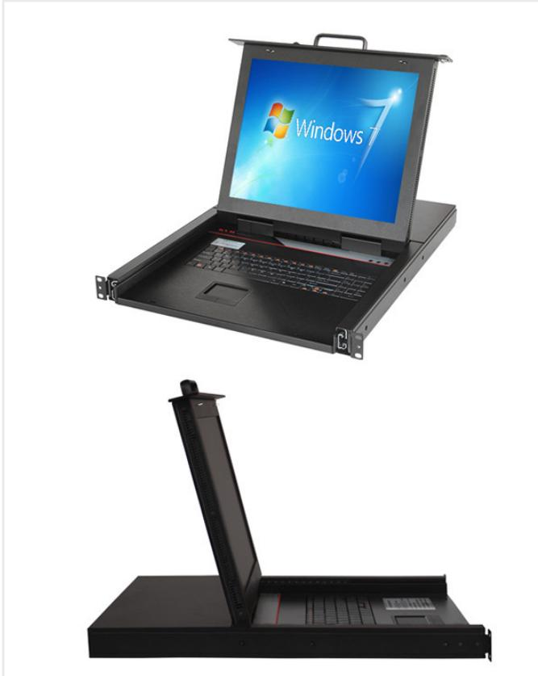
RACK KVM & REMOTE CONSOLE MANAGEMENT
Technical data · SP8732 · 1/2
PARAMETER
APPROVED SPECIFICATION
Port Connection
RJ45
Port Count
32
Input / Output
PS/2 / USB dual-interface converter module
Resolution
1280 × 1024
Scan Interval
5–255 seconds
Supported Systems
Windows, Vista, Linux, etc.
Power Input
A C100-240V, 50-60Hz, 1 A
Power Consumption
120V at 23 W; 230V at 25 W
SP8732
Optional Modules
CAT5 module or IP remote-access card module
Host Interface
USB / PS/2
SP8732 32-Port CAT5 Network KVM
Cascading
Supports bus and tree topologies
Dimensions
485 × 570 × 44 mm
Warranty
3 years for main unit; 1 year for display
Approved parameters 1–14 of 15
Product series
32-Port CAT5/IP KVM Series
This product section contains every approved customer-facing specification field for the exact model. Missing source values are stated explicitly.
NexPro Product Intelligence · Project configurations are confirmed through RFQ
13
Notes:
[Sources]
- D:\Nexpro-link 产品数据库\artifacts\NPL-DB-0203\product-artifact-manifest.json
- D:\NexPro-Link-安放解决方案供应商网站\src\data\products.ts
- D:\NexPro-Link-安放解决方案供应商网站\public\images\products\pdu-catalog\kvm-cat5\sp8732\099_sp8732_product.jpg

Slide 14
RACK KVM & REMOTE CONSOLE MANAGEMENT
Technical data · SP8732 · 2/2
PARAMETER
APPROVED SPECIFICATION
Product category
KVM
SP8732
SP8732 32-Port CAT5 Network KVM
Approved parameters 15–15 of 15
This product section contains every approved customer-facing specification field for the exact model. Missing source values are stated explicitly.
NexPro Product Intelligence · Project configurations are confirmed through RFQ
14
Notes:
[Sources]
- D:\Nexpro-link 产品数据库\artifacts\NPL-DB-0203\product-artifact-manifest.json
- D:\NexPro-Link-安放解决方案供应商网站\src\data\products.ts
- D:\NexPro-Link-安放解决方案供应商网站\public\images\products\pdu-catalog\kvm-cat5\sp8732\099_sp8732_product.jpg

Slide 15
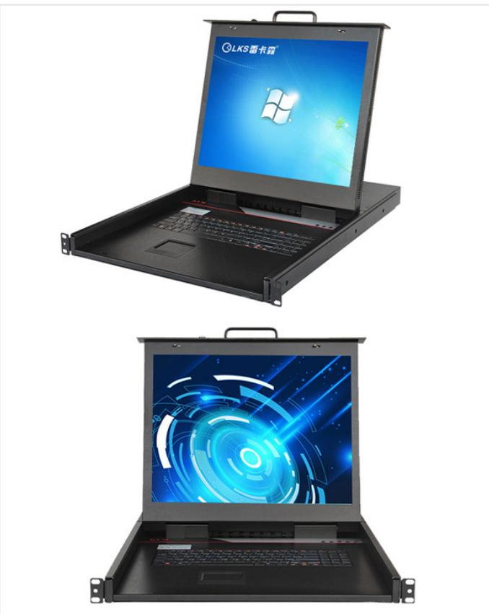
RACK KVM & REMOTE CONSOLE MANAGEMENT
Technical data · SP8932 · 1/2
PARAMETER
APPROVED SPECIFICATION
Maximum Cascade Capacity
Up to 256 devices
Port Count
catalog value: 16
Input / Output
PS/2 / USB dual-interface converter module
Resolution
1280 × 1024
Scan Interval
1–255 seconds
Supported Systems
Windows, Vista, Linux, etc.
Power Input
A C100-240V, 50-60Hz, 1 A
Power Consumption
120V at 23 W; 230V at 25 W
SP8932
Operating Temperature
0-40℃
Storage Temperature
-20-60℃
SP8932 CAT5/IP KVM (Port Description Requires Review)
Humidity
0-80%RH, non-condensing
Dimensions
485 × 600 × 44 mm
Warranty
3 years for main unit; 1 year for display
Approved parameters 1–14 of 15
Product series
32-Port CAT5/IP KVM Series
This product section contains every approved customer-facing specification field for the exact model. Missing source values are stated explicitly.
NexPro Product Intelligence · Project configurations are confirmed through RFQ
15
Notes:
[Sources]
- D:\Nexpro-link 产品数据库\artifacts\NPL-DB-0203\product-artifact-manifest.json
- D:\NexPro-Link-安放解决方案供应商网站\src\data\products.ts
- D:\NexPro-Link-安放解决方案供应商网站\public\images\products\pdu-catalog\kvm-cat5\sp8932\100_sp8932_product.jpg

Slide 16
RACK KVM & REMOTE CONSOLE MANAGEMENT
Technical data · SP8932 · 2/2
PARAMETER
APPROVED SPECIFICATION
Product category
KVM
SP8932
SP8932 CAT5/IP KVM (Port Description Requires Review)
Approved parameters 15–15 of 15
This product section contains every approved customer-facing specification field for the exact model. Missing source values are stated explicitly.
NexPro Product Intelligence · Project configurations are confirmed through RFQ
16
Notes:
[Sources]
- D:\Nexpro-link 产品数据库\artifacts\NPL-DB-0203\product-artifact-manifest.json
- D:\NexPro-Link-安放解决方案供应商网站\src\data\products.ts
- D:\NexPro-Link-安放解决方案供应商网站\public\images\products\pdu-catalog\kvm-cat5\sp8932\100_sp8932_product.jpg

Slide 17
RACK KVM & REMOTE CONSOLE MANAGEMENT
Technical selection snapshot
Exact model
SP8032
SP1708-C
SP5916
SP8932
Product
SP8032 16-Port Digital KVM
SP1708-C 8-port local VGA KVM (1920 × 1080)
SP5916 16-Port Remote IP KVM, 600 mm Depth
SP8932 CAT5/IP KVM (Port Description Requires Review)
Key specification 1
Configurations: 2
Port Count: 8
Port Count: 16
Maximum Cascade Capacity: Up to 256 devices
Key specification 2
Server Ports: 16
Resolution: 1920 × 1080
Resolution: 1280 × 1024
Port Count: catalog value: 16
Application fit
Server rack management · Data center operations · Rem…
Local server management · Data-room racks · Maintenan…
Remote server access · Data center operations · Netwo…
High-density server racks · CAT5 KVM extension · Data…
Use the detailed Word specification documents for complete approved attributes and family variant tables.
NexPro Product Intelligence · Project configurations are confirmed through RFQ
17
Notes:
[Sources]
- D:\Nexpro-link 产品数据库\artifacts\NPL-DB-0203\product-artifact-manifest.json

Slide 18
RACK KVM & REMOTE CONSOLE MANAGEMENT
Approved model register
SP8032
SP1708-B
SP1708-C
SP5716
SP5916
SP8732
SP8932
7 exact website model records shown on this page · 7 total for this product line
NexPro Product Intelligence · Project configurations are confirmed through RFQ
18
Notes:
[Sources]
- D:\Nexpro-link 产品数据库\artifacts\NPL-DB-0203\product-artifact-manifest.json
- D:\NexPro-Link-安放解决方案供应商网站\src\data\products.ts

Slide 19
RACK KVM & REMOTE CONSOLE MANAGEMENT
Procurement and RFQ checklist
01
Quantity & mix
Confirm by model and project quantity
Include in your inquiry
02
Lead time
Confirm after configuration review
Exact model or required function
Estimated quantity
Destination country or port
Required interfaces / accessories
Documentation and OEM/ODM needs
03
Shipping basis
Confirm in project quotation
04
OEM / ODM
To be confirmed
Final configuration, availability and commercial terms are confirmed in the project quotation.
NexPro Product Intelligence · Project configurations are confirmed through RFQ
19
Notes:
[Sources]
- D:\Nexpro-link 产品数据库\artifacts\NPL-DB-0203\product-artifact-manifest.json

Slide 20
READY FOR THE PROJECT LIST
Share your requirements.
We will shortlist the right models.
Rack KVM & Remote Console Management
REQUEST A PROJECT QUOTATION
NexPro · 20
Notes:
[Sources]
- D:\Nexpro-link 产品数据库\artifacts\NPL-DB-0203\product-artifact-manifest.json
- D:\Nexpro-link 产品数据库\artifacts\NPL-DB-0304\assets\nexpro-technical-background-v1.png

